Slide 1
ANDROS
Welcome to Andros the island of your imagination! It is a perfect island where you can relax,unwind and enjoy the sparkling crystal clear waters your imaginationary vacation starts now.

Slide 2
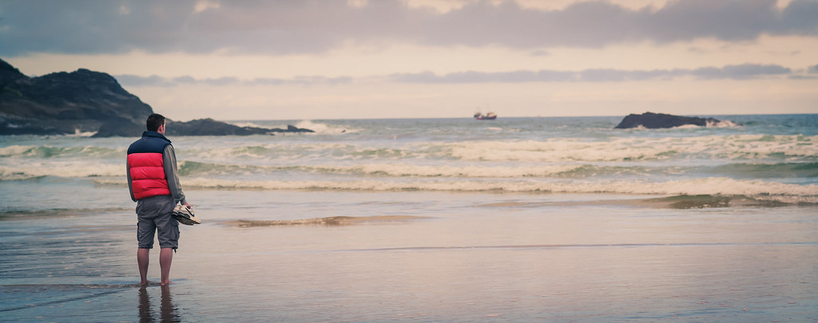
FAMOUS LAND MARKS
Andros is home to some of the most famous beaches where there is romance why not sit back,relax and work on you tan or if your more adventurous go snorkling beneaf the blue shimmering waters.
This Photo by Unknown Author is licensed under CC BY-SA
This Photo by Unknown Author is licensed under CC BY-SA-NC

Slide 3
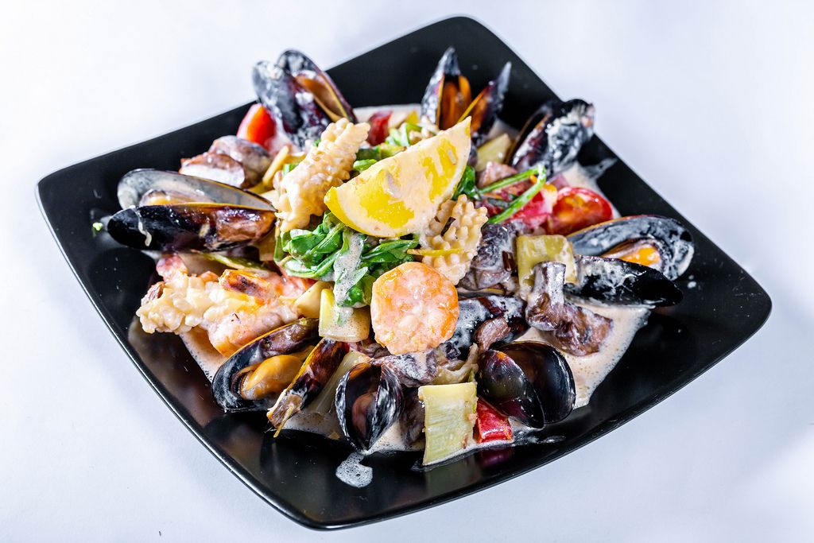
MOUTH WATERING FOOD
Greek cuisine is famous around the hole world and in Andros you can taste mouthwatering octopus at its finest
Geek cuisine is famous around the hole world and in Andros you can taste mouthwatering octopus
This Photo by Unknown Author is licensed under CC BY

Slide 4
SHOP UNTIL YOU DROP
Andros is filled with anti gravity pants , suits , and dresses and lots more with hand made jewlery.
This Photo by Unknown Author is licensed under CC BY-SA

Slide 5
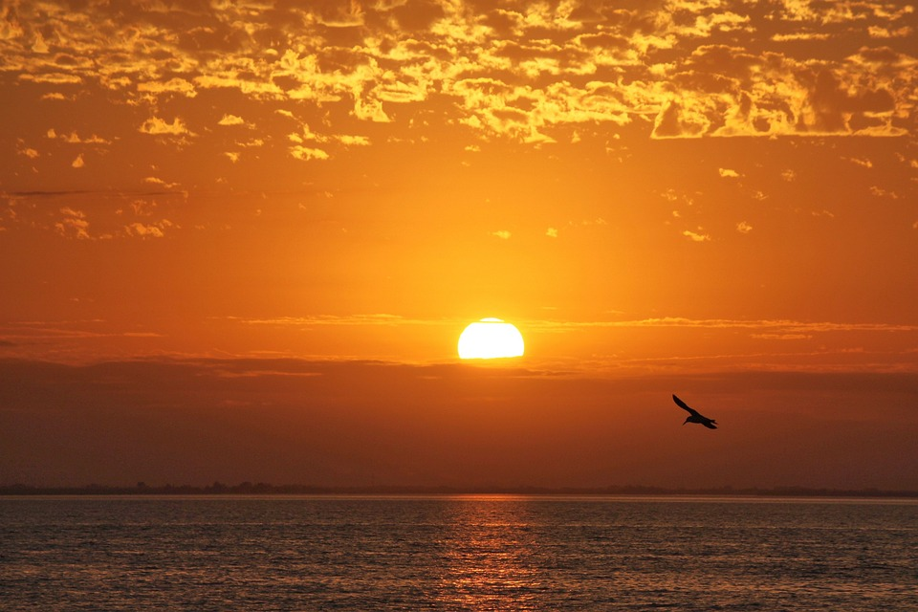
SUNNY DAYS
Andros has year round glimmering sunshine all day and night in fact 24/7

Slide 6
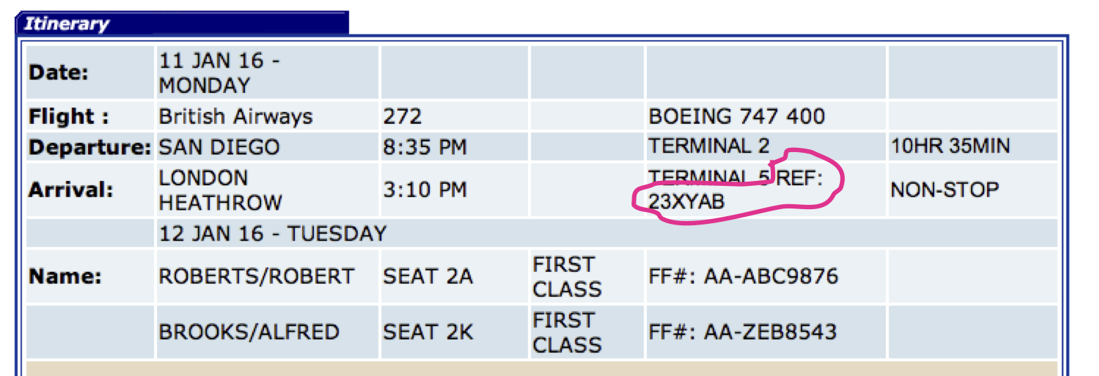
GET HERE NOW
So what are you waiting for get on that computer/laptop and book those flights book them back to.
This Photo by Unknown Author is licensed under CC BY-SA
This Photo by Unknown Author is licensed under CC BY-SA

Slide 7
HOPE YOU HAD A GOOD TIME ☺
This Photo by Unknown Author is licensed under CC BY-SA

