Slide 1
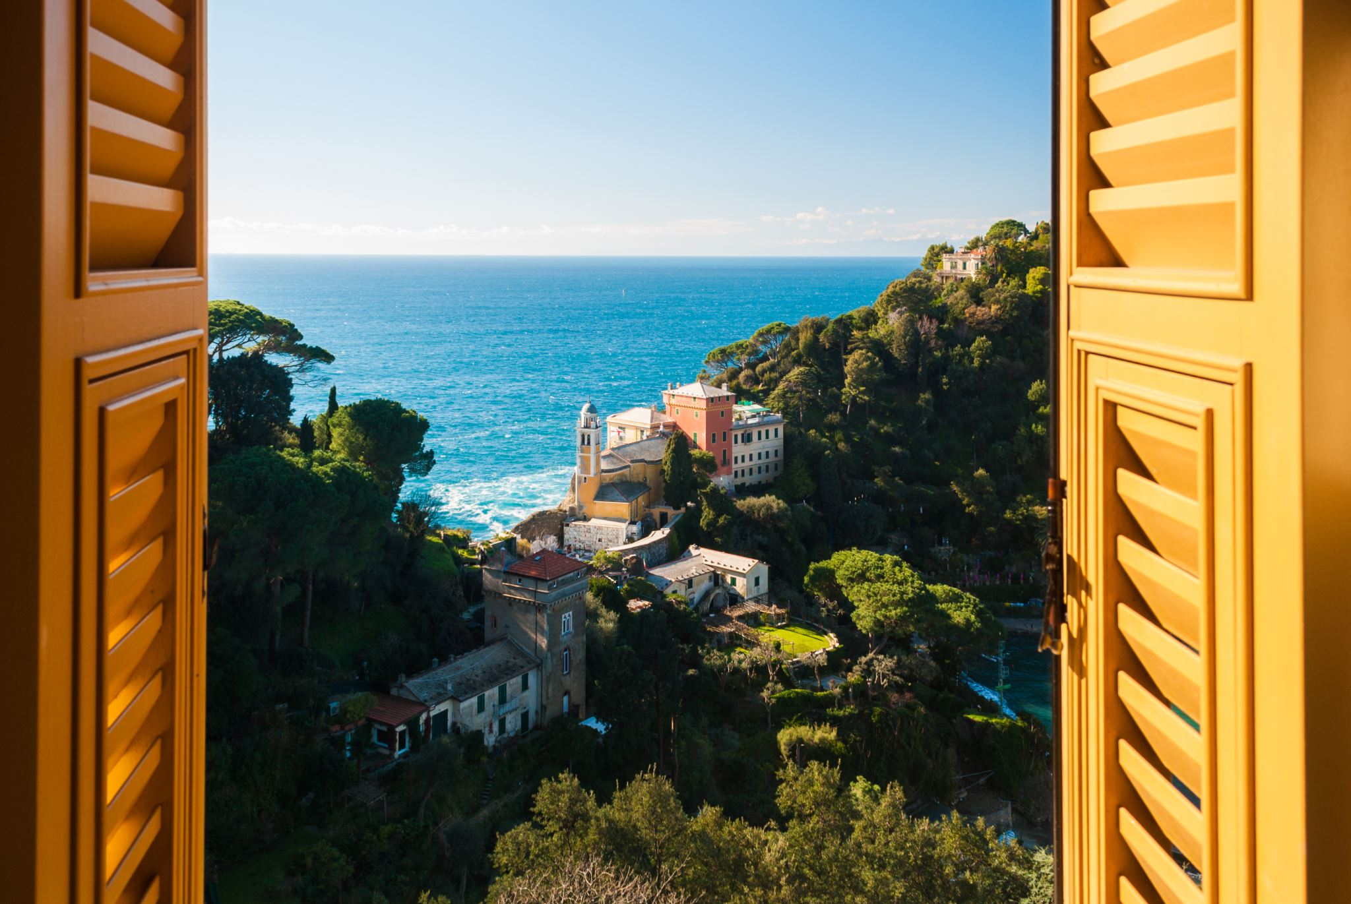
CORFU
By
Emily
And
Oliver

Slide 2
Welcome to Corfu
The island of dreams
Are you ready to explore this heavenley holiday?
Corfu feels like a dream when you see the beautiful sights .

Slide 3
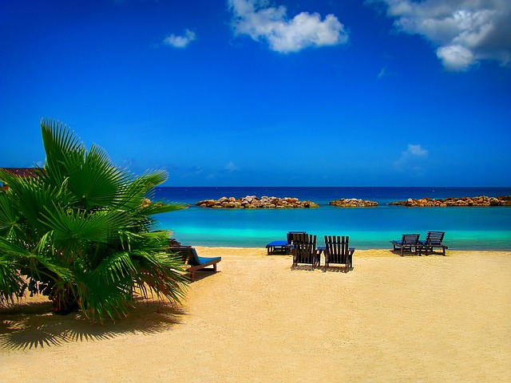
THINGS TO DO :
Looking for things to do ? Then carry on reading!!!There is lots to do in Corfu , you can have a day at the beach if you are looking to work on your tan ,or maybe explore the ancient wonders of the amazing Greek temples .If you fancy something more adventureous then you can book yourself a diving session were you can dive to victory .

Slide 4
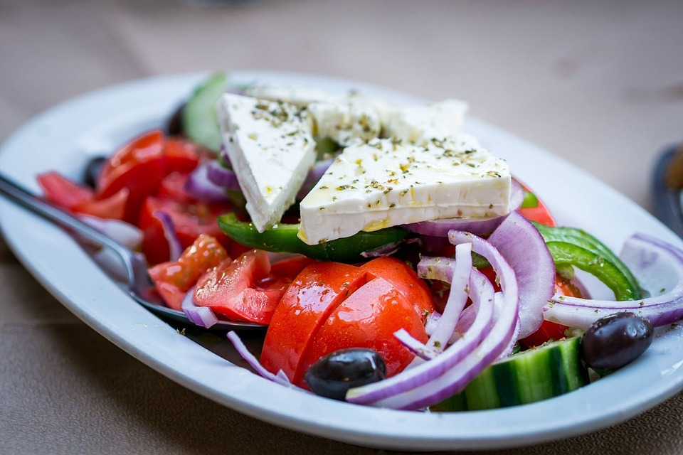
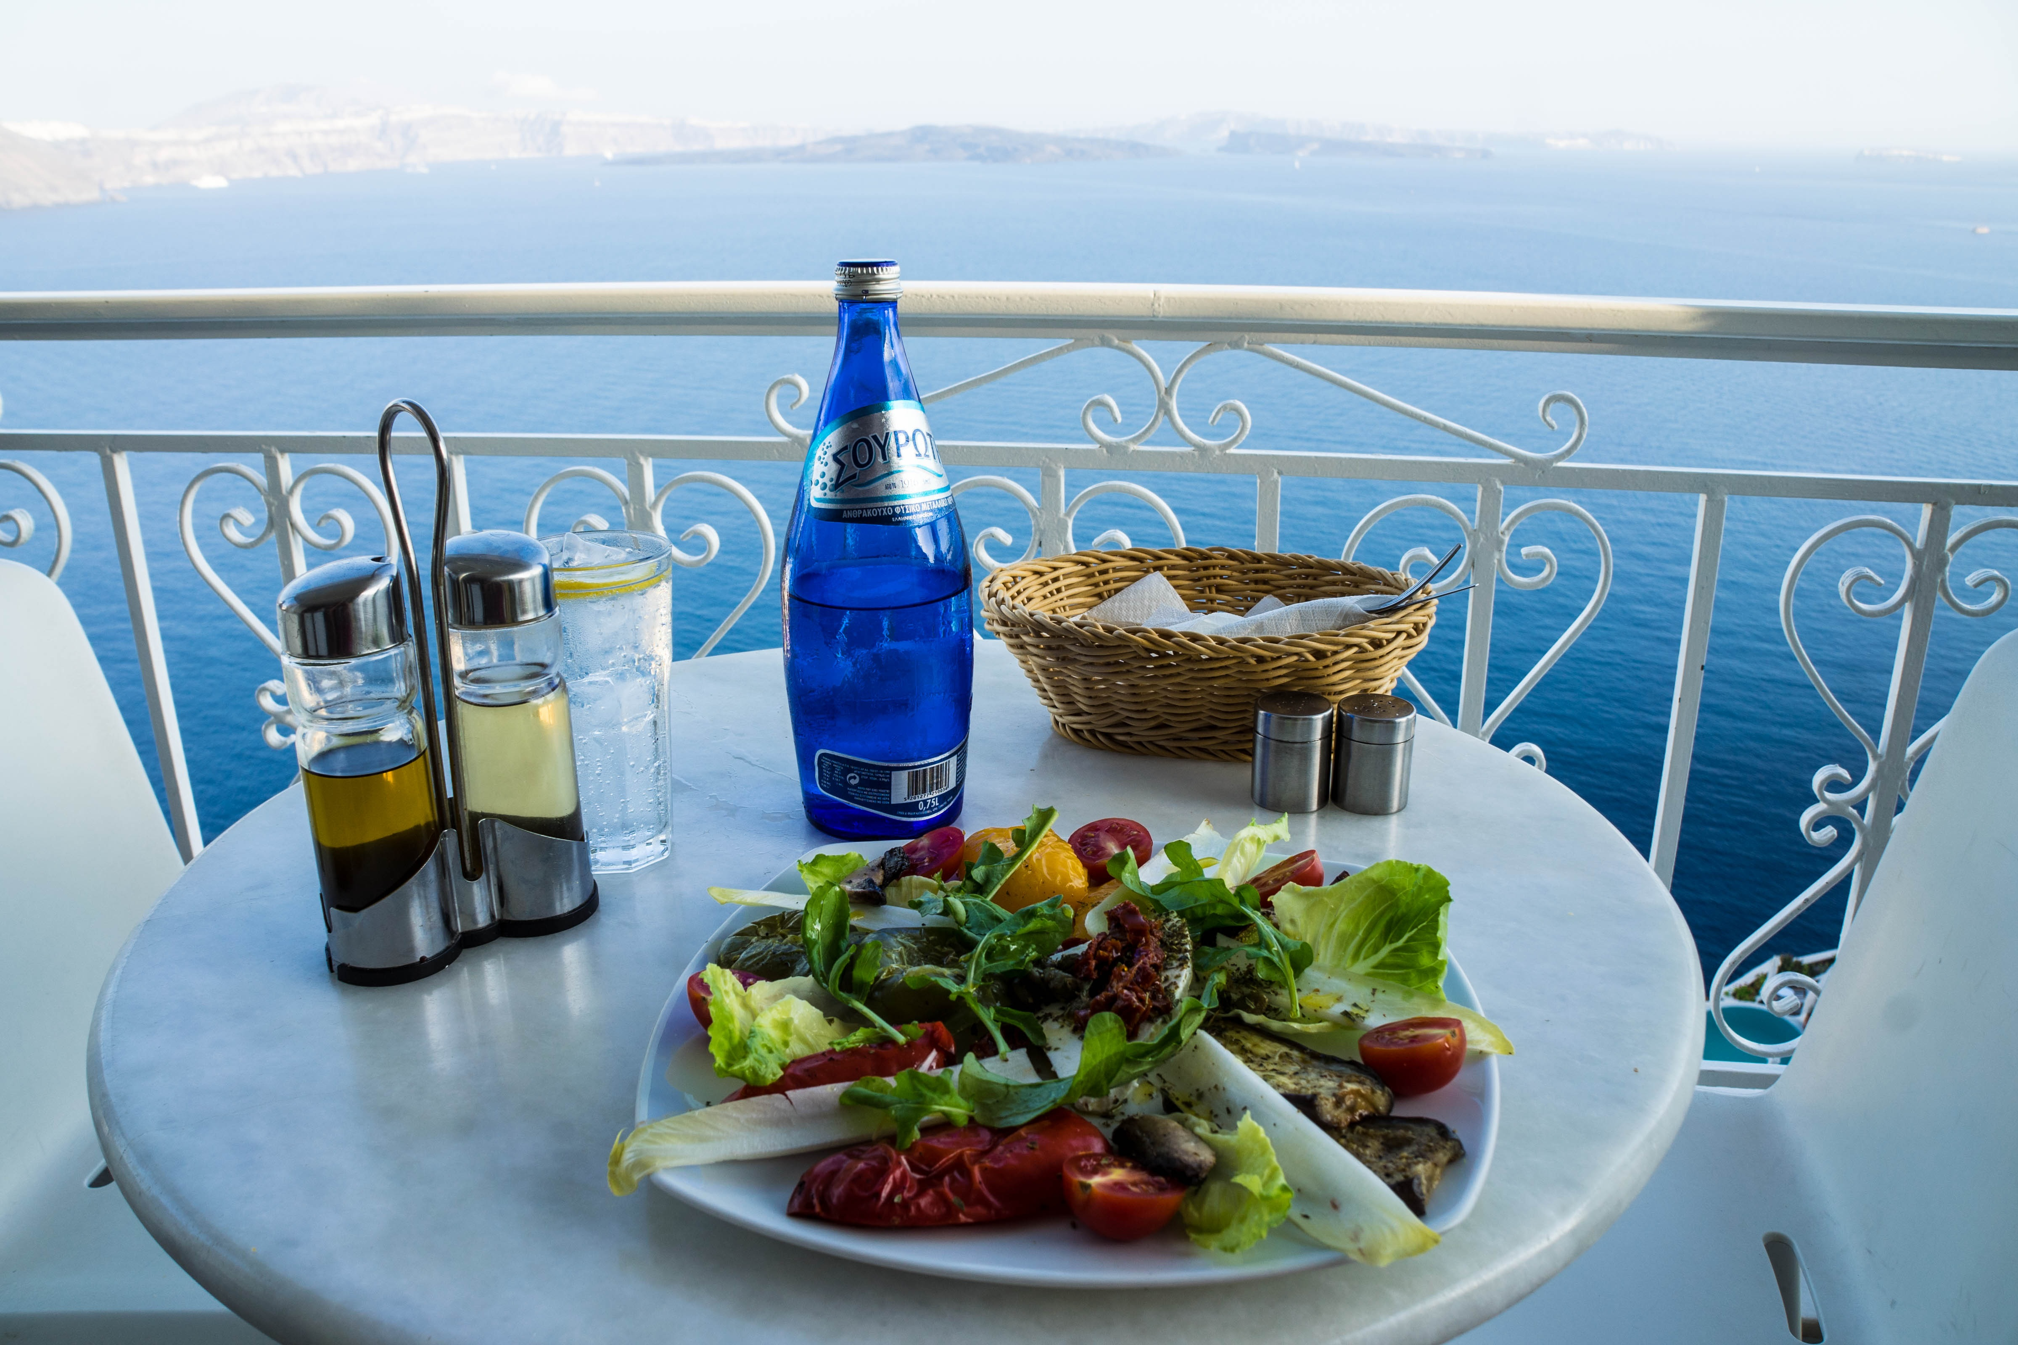

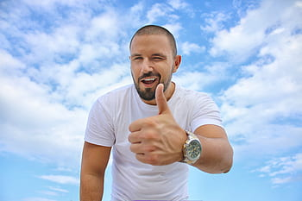
GREEK CUISINE
Greek cuisine is famous round the world .In Corfu you can taste it at its freshest ,from its georgous Greek salads to juicy gyros and rich backlava .The local dishes will satisfy any craving ,why not enjoy your meal at an open roof cruise ? You can count on us to make your meal delicious !

Slide 5


SHOP TIL YOU DROP:
Looking for a small gift to remember
Your fab holiday ? Then follow these
Instructions .

