Slide 1
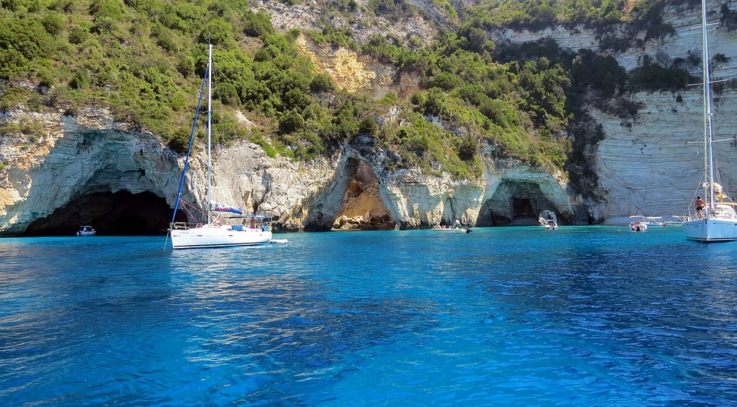
Welcome to paxos
Welcome to paxos
Welcome to paxos the island of surprise ! Paxos is perfet island for people that like views ,relaxing,romantic spots and shopping..do you love breath-taking sights? You can only get to paxos by boat .
Welcome to Paxos the island of surprises! Paxos is perfect island for people that like views ,relaxing / romantic spots and shopping .Do you love breath – taking sights? You can only get to Paxos by boat .

Slide 2
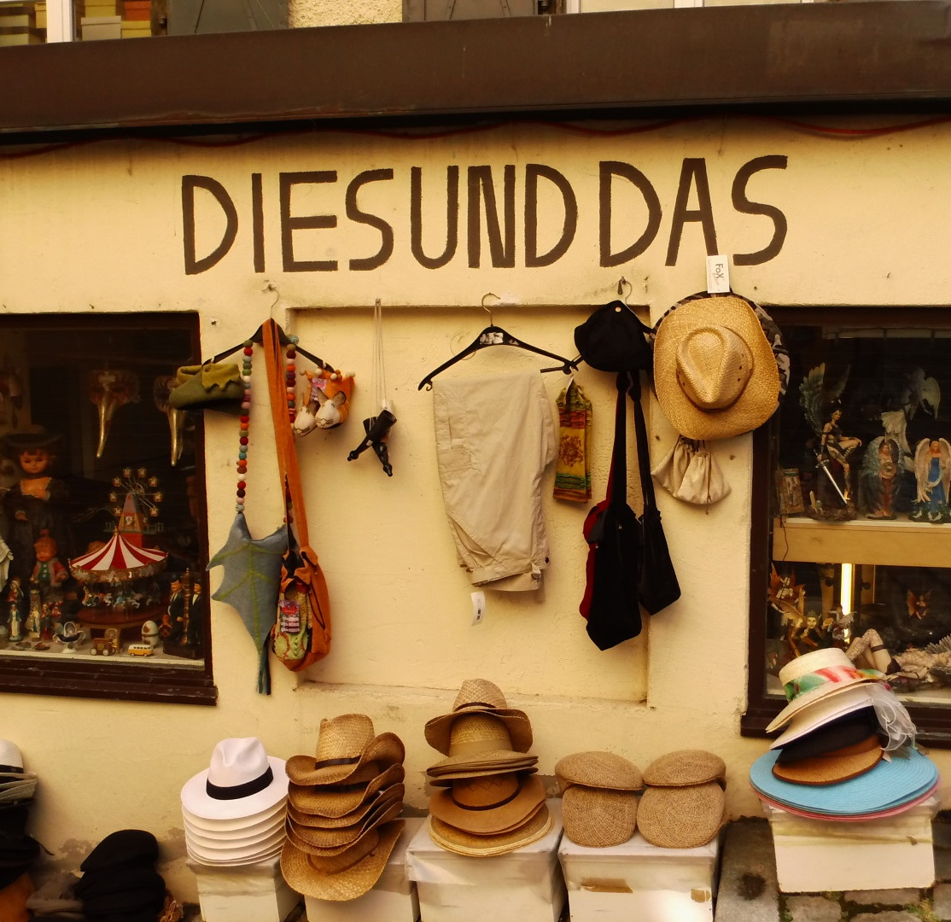
Things to do in Paxos
Paxos is home to famous beach in the world! Paxos is one of the smallest places in the world! Get ready to go on a adventure of wonders and views that you have never seen before . Would you like you like to take a relaxing boat ride past crystal clear waters and caves that you have seen before ?

Slide 3
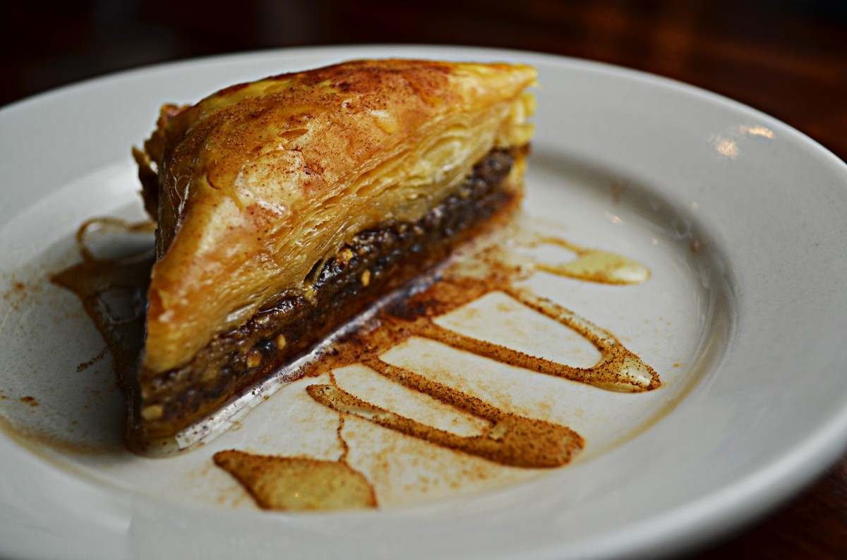
Delicious Greek cuisine
Greek cuisine is famous around the world! Leading to mouth watering slavaki and fresh coureful salad and jaw dropping baklava . Would you like to go to a romantic mountain restaurant , while gazing at the moonlight shining on the mountain

