Slide 2
Monday
mayhem
1.Read the word.
2.Dots & dashes.
3. Shout the word
4. Whisper the word
5. Clap syllables
6.. Act it out!

Slide 3
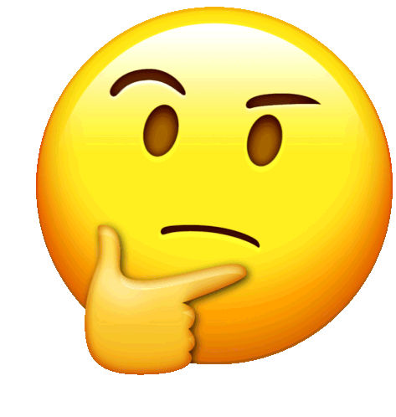
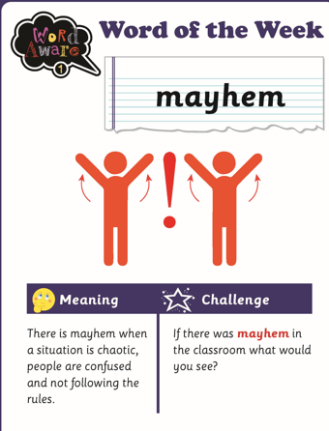
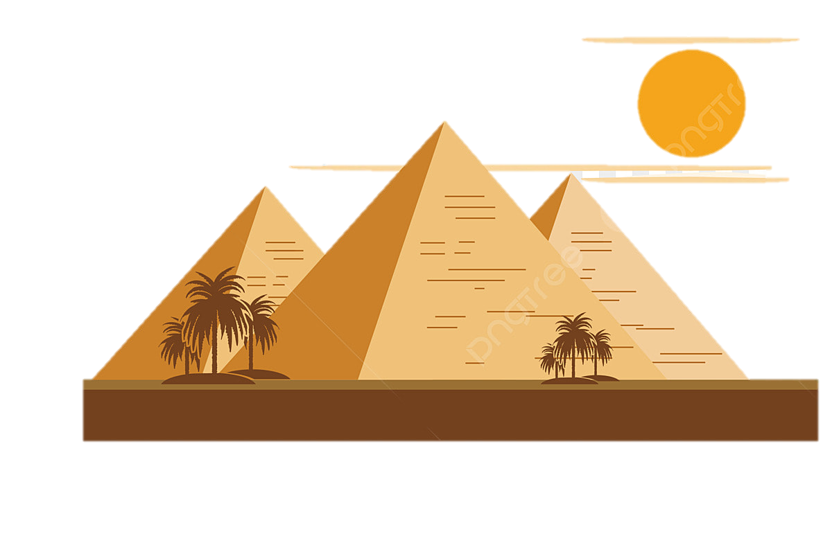
mayhem
Meaning:
Challenge:find a synonym for mayhem

Slide 4
Tuesday y
mayhem
Meaning:

Slide 5
Joke: Why did the ancient pyramid call the pizza place?

Slide 6
Answer: Because it wanted a slice of history.

Slide 7
mayhem

Slide 8
Wednesday
mayhem
Tuesday

Slide 9
_ayhem

Slide 10
M-yhem

Slide 11
May---

Slide 12
May--m

Slide 13
Mayh---

Slide 14
_______

Slide 15
Thursday
mayhem
Tuesday
Meaning:

Slide 16
Thursday
How might you use this week’s Word Aware word in a sentence?
________________________________________________________________________________________________________________________________________________________________________________________________________________________________________________________________________________________________________

Slide 17
Friday
Review.
What was this week’s Word Aware word?
What does our word mean?
How are you going to remember the word?
When might you use our word next?

