Slide 1
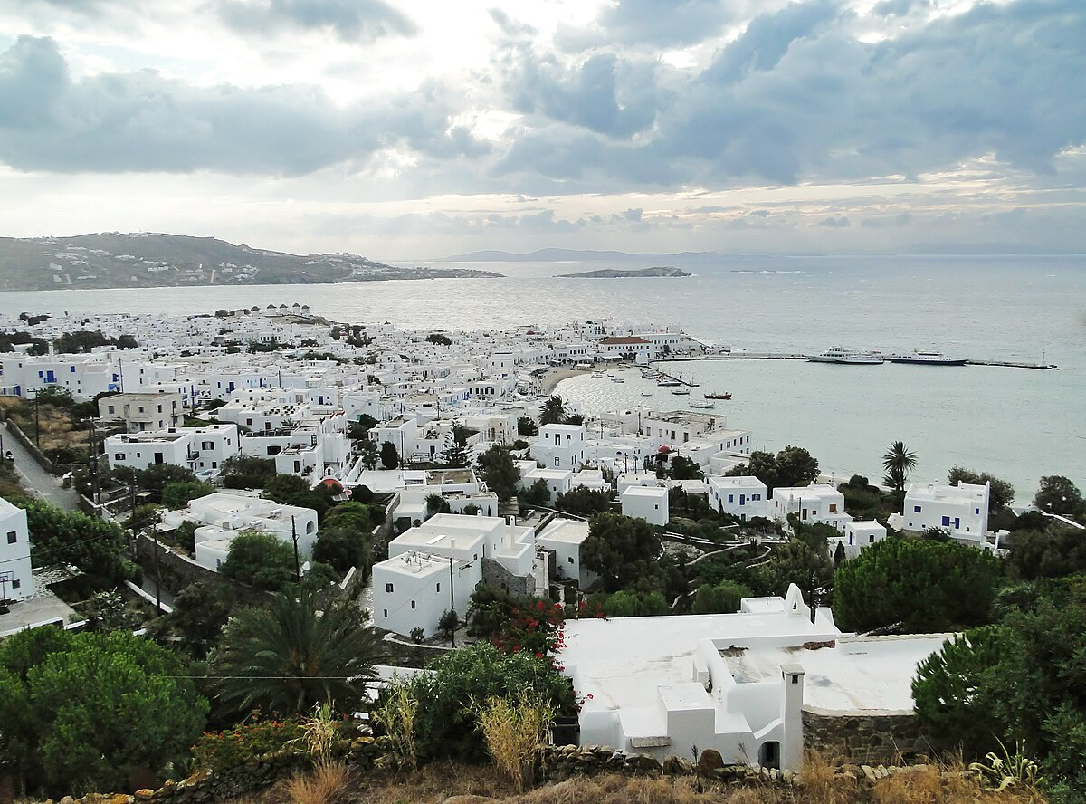
WELCOME TO MYkONOS
This Photo by Unknown Author is licensed under CC BY-SA

Slide 2
Mykonos
Welcome to Mykonos the place of wonders-
A fun fact is Mykonos is one of the largest Greek islands in the world and is a family favourite.

Slide 3
Things to do☺
If you need something to do I suggest you go on a half day cruse around Mykonos for £52 or you can go on a half day highlights of Mykonos for £64 or go to the beach for free.
This Photo by Unknown Author is licensed under CC BY-SA

Slide 4
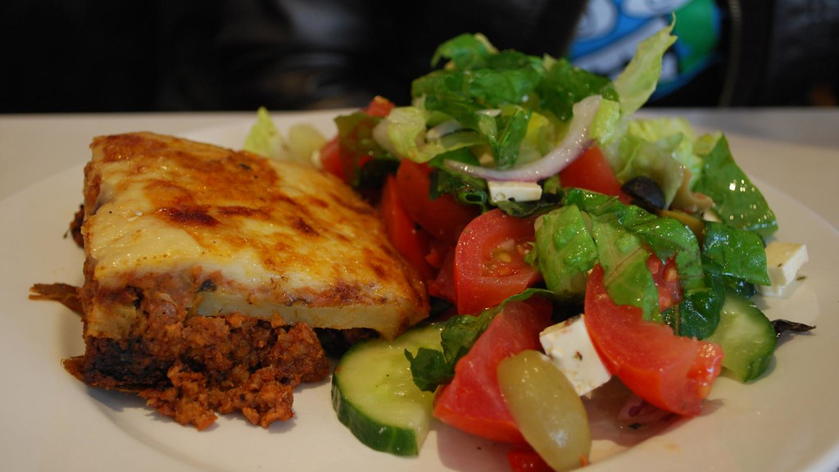
Yummy things to eat☺
This Photo by Unknown Author is licensed under CC BY-SA
Are you hungry ? Of course you are, maybe eat some tuna tarta or some yummy seafood pasta or some amazing sovlaki to fill your tummy .

Slide 5
Shop Till You Drop
If you want to get a suvarnear go to the local markets were they sell jewellery ,vases and 3D prints . Along with more.
This Photo by Unknown Author is licensed under CC BY-SA-NC

Slide 6
Why Choose Mykonos ?
year round sunshine.
FUN FUN FUN FUN.

