Slide 1
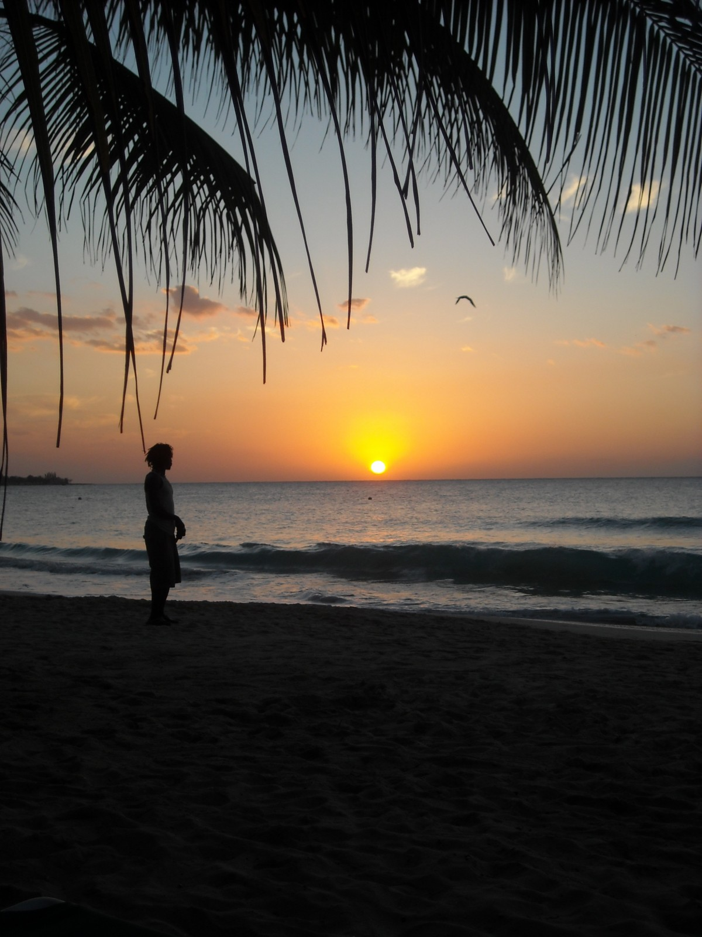
Naxos
Welcome to Naxos (the island that combines Greece and imagination)

Slide 2
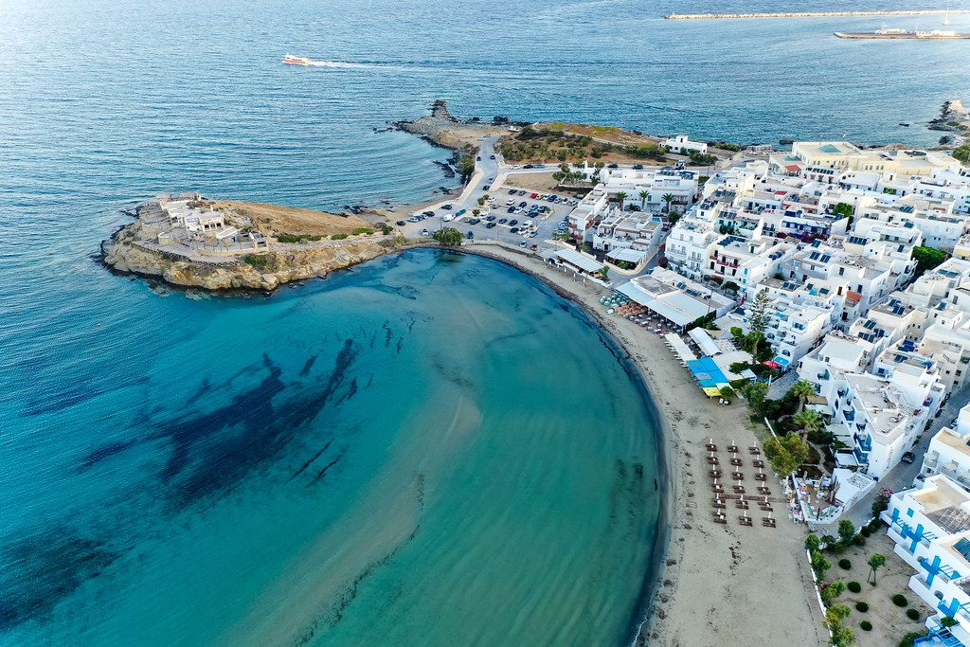
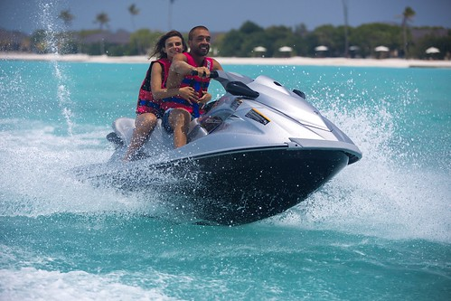
Lesiure
Naxos has kitesurfing,windsurfing,jet-skieing and waterskieing.Just chill on a relaxing island or surf up them waves!
This Photo by Unknown Author is licensed under CC BY

Slide 3
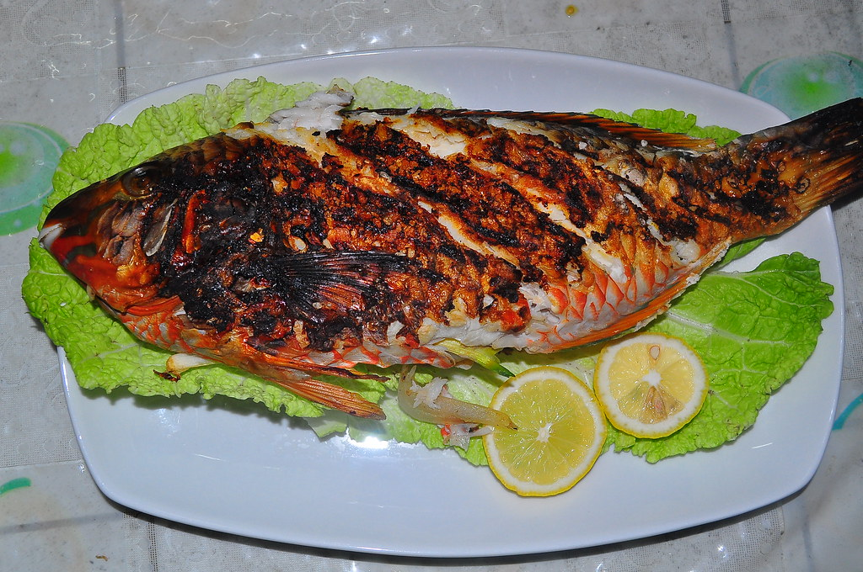
Delicious Naxos cuisene
If your in Naxos you can feast upon Fresh fish,juicy cuts,local cheese,Naxian potato dishes and walnut and orange cake.
This Photo by Unknown Author is licensed under CC BY

Slide 4
Shop until you drop!
You can buy Art,Sandals,Local products,Soap,Ceramics and wine!
This Photo by Unknown Author is licensed under CC BY-NC

Slide 5
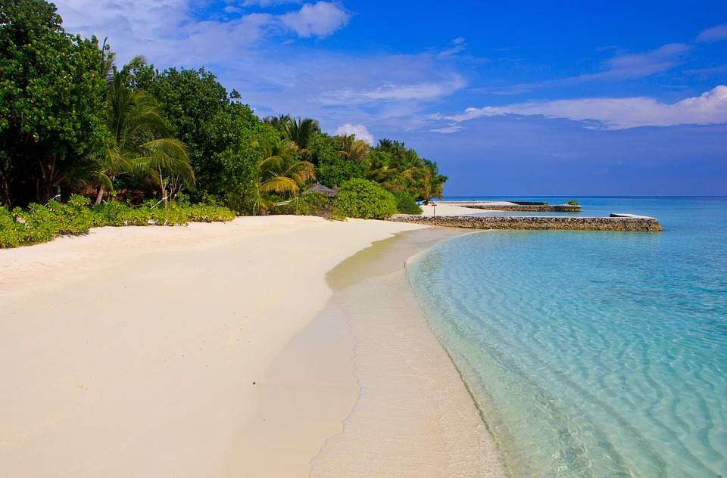
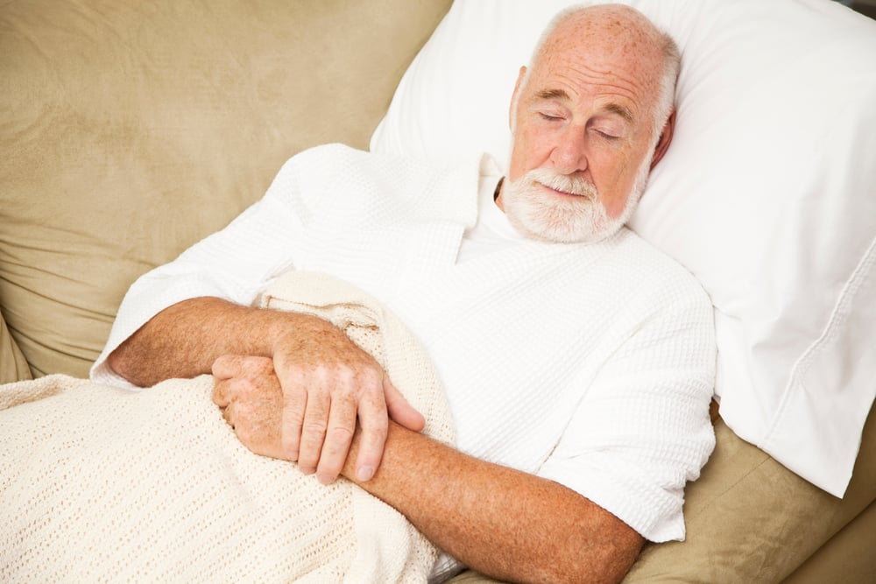
Why choose!
Naxos is a really relaxing island where you can rest forever!
This Photo by Unknown Author is licensed under CC BY-NC-ND

Slide 6
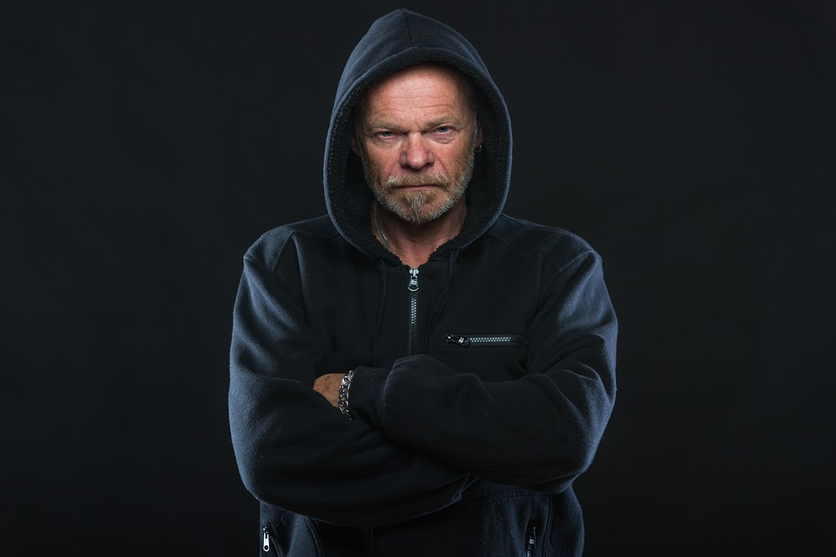
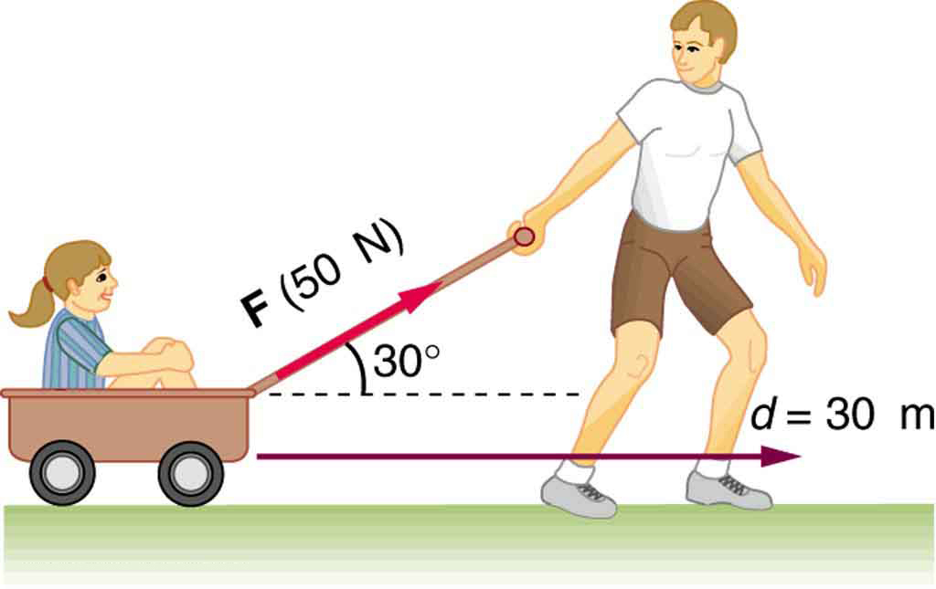
Concluding line
Why are you just sitting there?
GET HERE NOW!
This Photo by Unknown Author is licensed under CC BY
This Photo by Unknown Author is licensed under CC BY-SA

