Slide 1
☺☺☺☺☺☺☺☺
Hope you enjoy☺
This Photo by Unknown Author is licensed under CC BY-NC

Slide 2
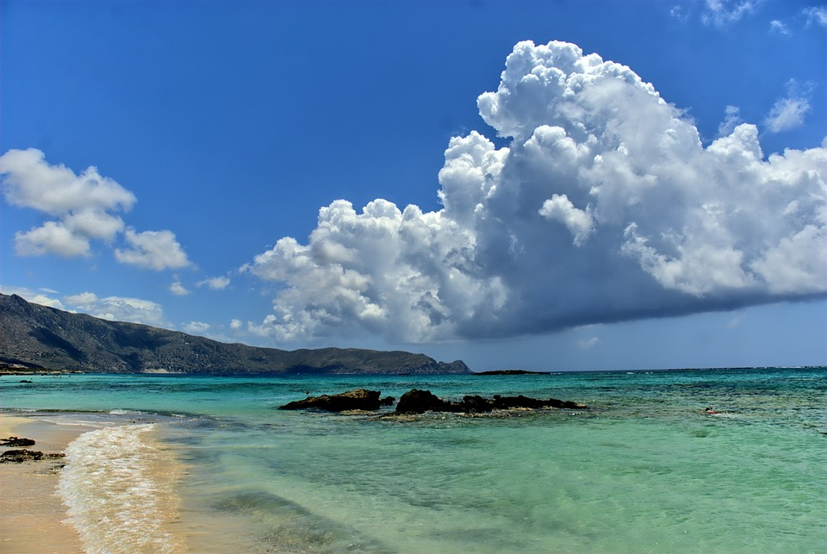
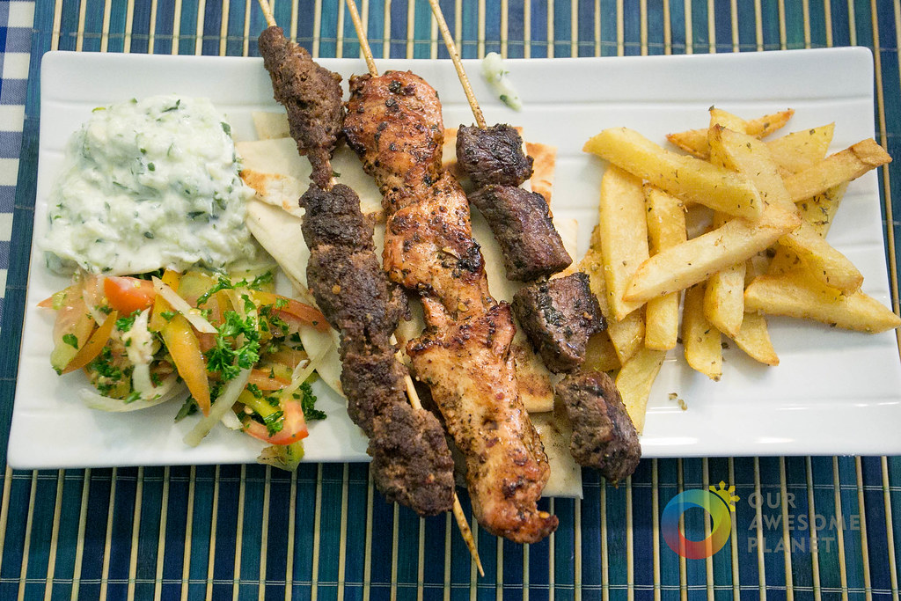
Crete ☺
Welcome to Crete-The island of paradise! Crete is the most populous and largest island in Greece. Crete is a wonderful place for a family vacation where you can relax at the beach and swim in the crystal , clear water. Your dream vacation starts now!
This Photo by Unknown Author is licensed under CC BY-SA-NC

Slide 3
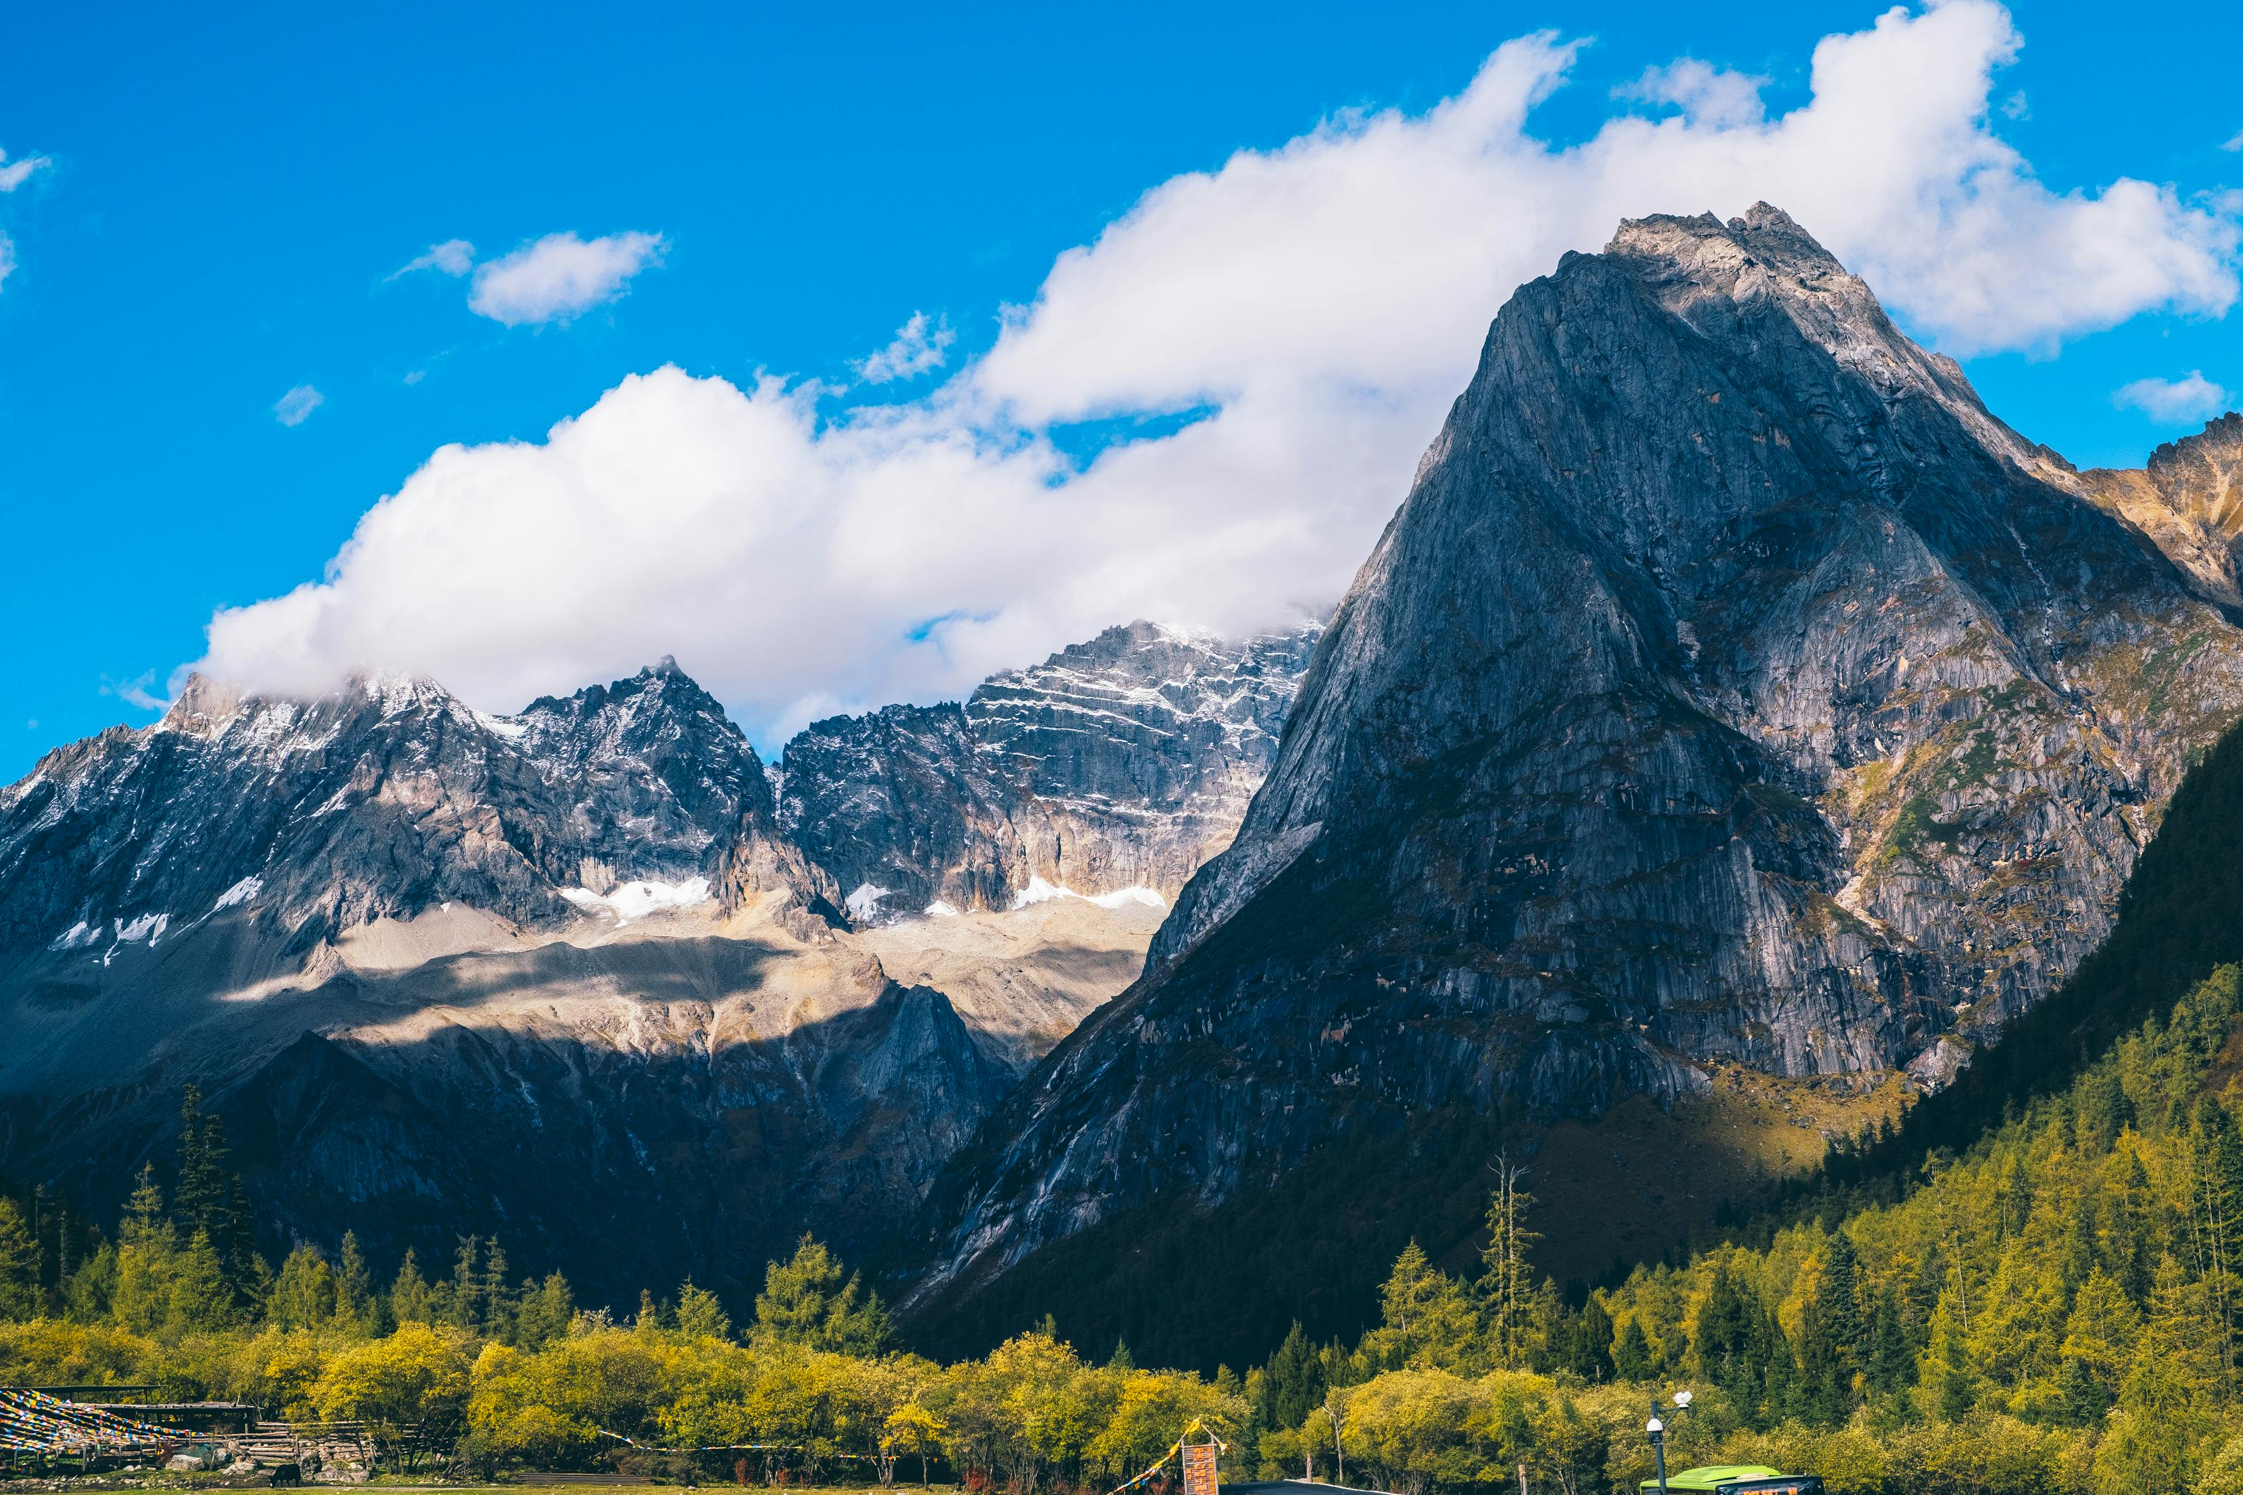
Things to do
Crete is a amazing place for adventurous people because there are many mountains and hills to climb or you can sunbave and watch your kids swim in the crystal , clear ocean.

Slide 4
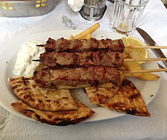
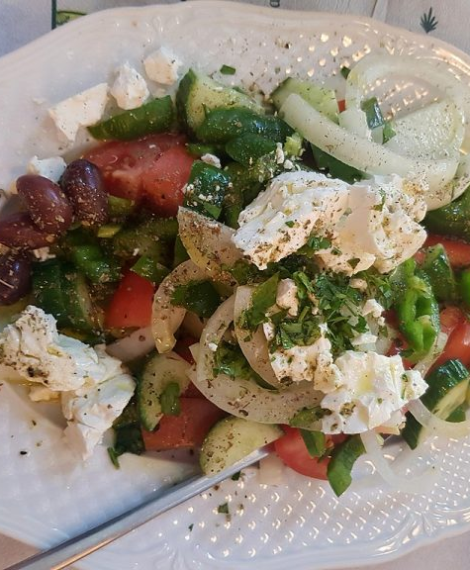
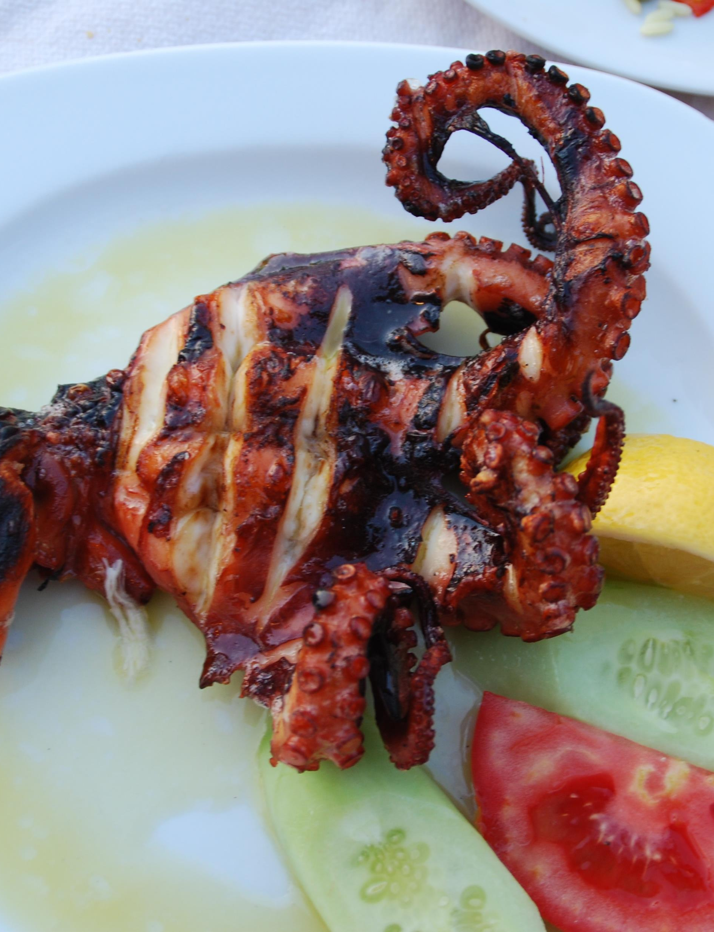
Things to eat
You can eat homemade Greek salad , delicious scrumptious moussaka , spanakopita , orange cake and pitta bread with a side of hummus. These local dishes will satisfy any craving . Why not enjoy your meal at a beach side restraunt while gazing at the cotton candy sunset while waiting for your meal.
This Photo by Unknown Author is licensed under CC BY-SA
This Photo by Unknown Author is licensed under CC BY-SA

Slide 5
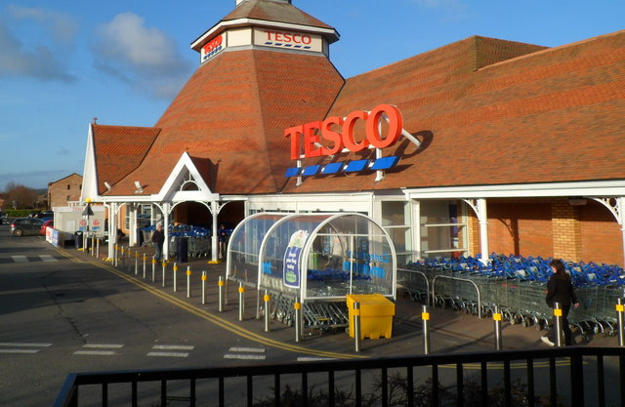
Shop until you drop
Crete has many shops with homemade jewellery , ancient Greek vases and traditional bracelets and ankelets for friends and family to enjoy wearing .Why not grab a drink and sit on the beach .
This Photo by Unknown Author is licensed under CC BY-SA
This Photo by Unknown Author is licensed under CC BY-SA-NC

Slide 6
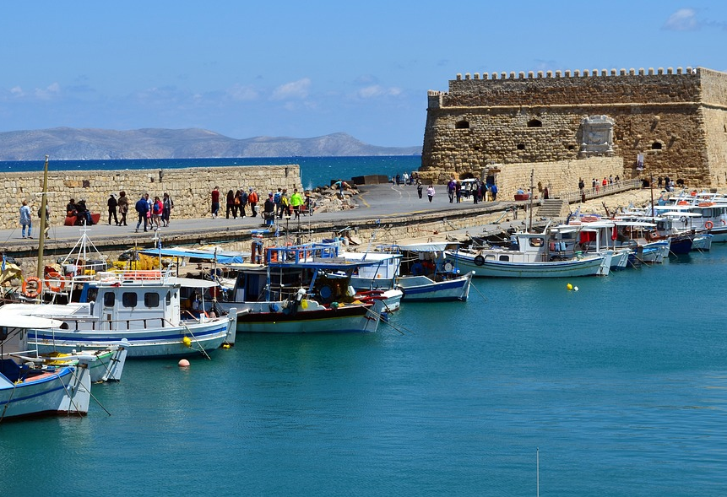
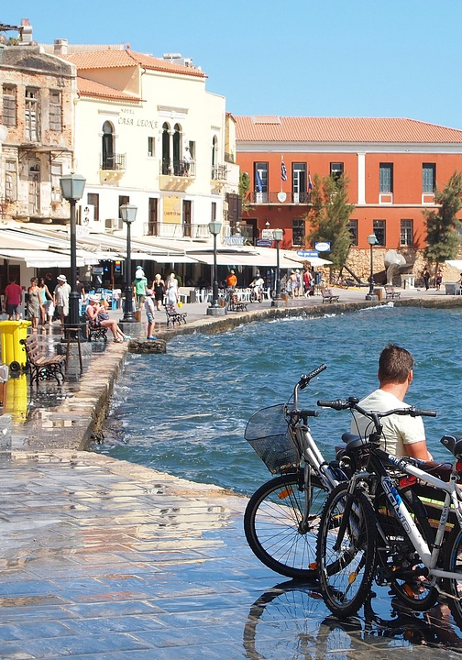
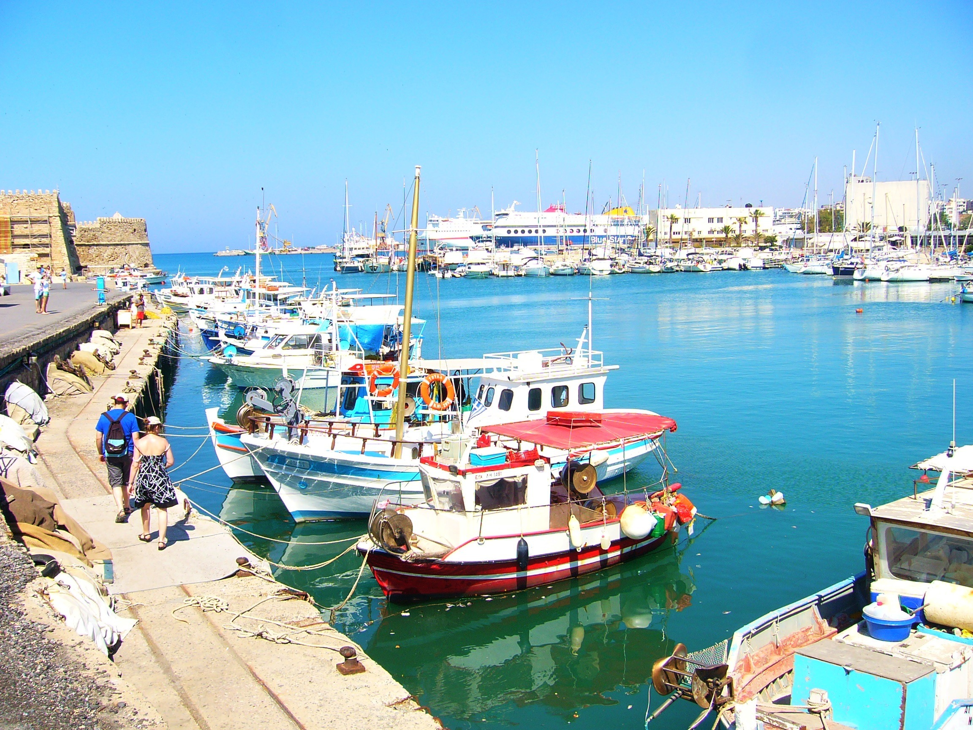
Crete has year round sunshine , friendly locals and is a paradise for everyone and all ages are aloud , small to large everyone is aloud.

Slide 7
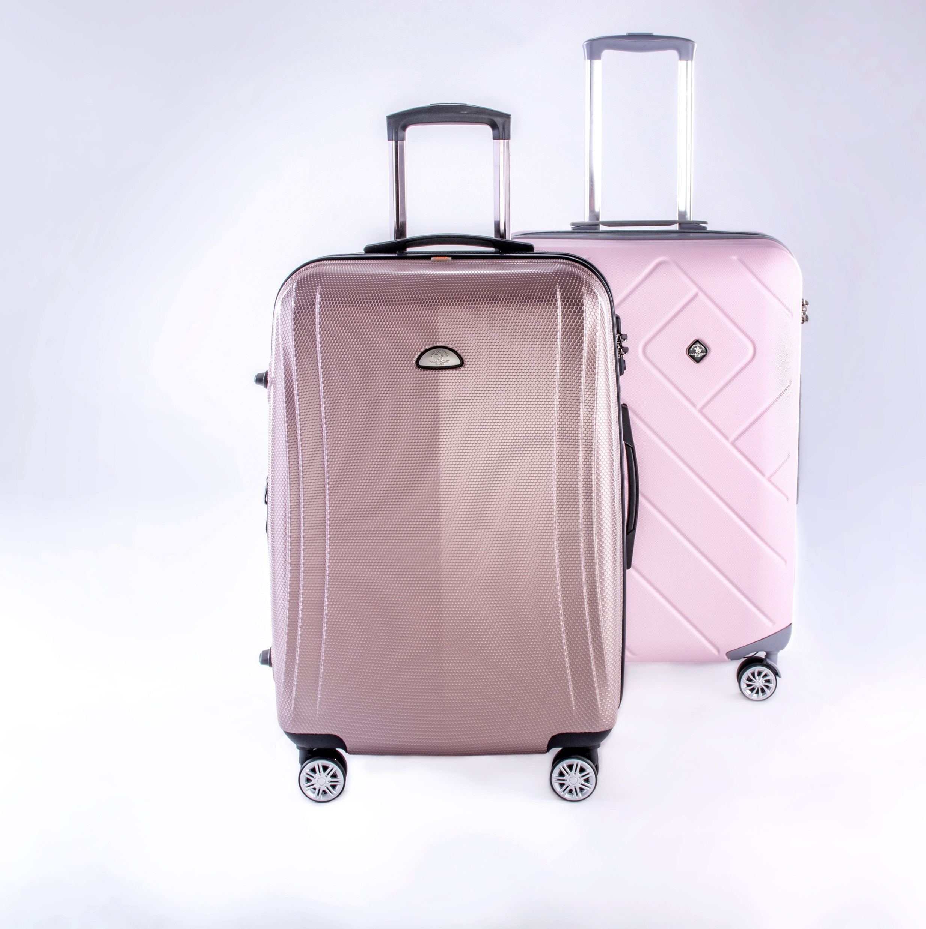
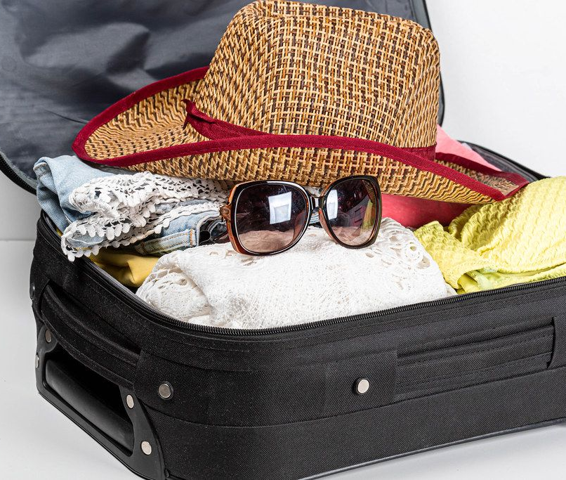
So what are you waiting for?book your flight and pack your bags and make sure to pack your snuggly teddys !!
This Photo by Unknown Author is licensed under CC BY

Slide 8
☺ OR ☹
Hope you enjoyed it ☺
See you another time☺
This Photo by Unknown Author is licensed under CC BY-SA

