Slide 1
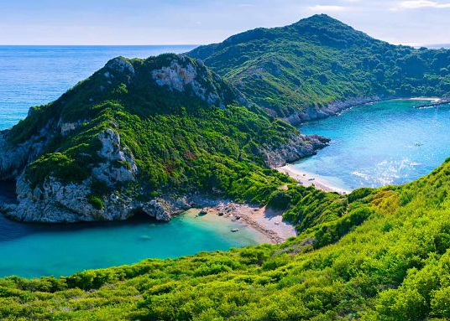
Welcome to Corfu
One of the nicest Greek islands in the world.
This Photo by Unknown Author is licensed under CC BY-NC-ND

Slide 2
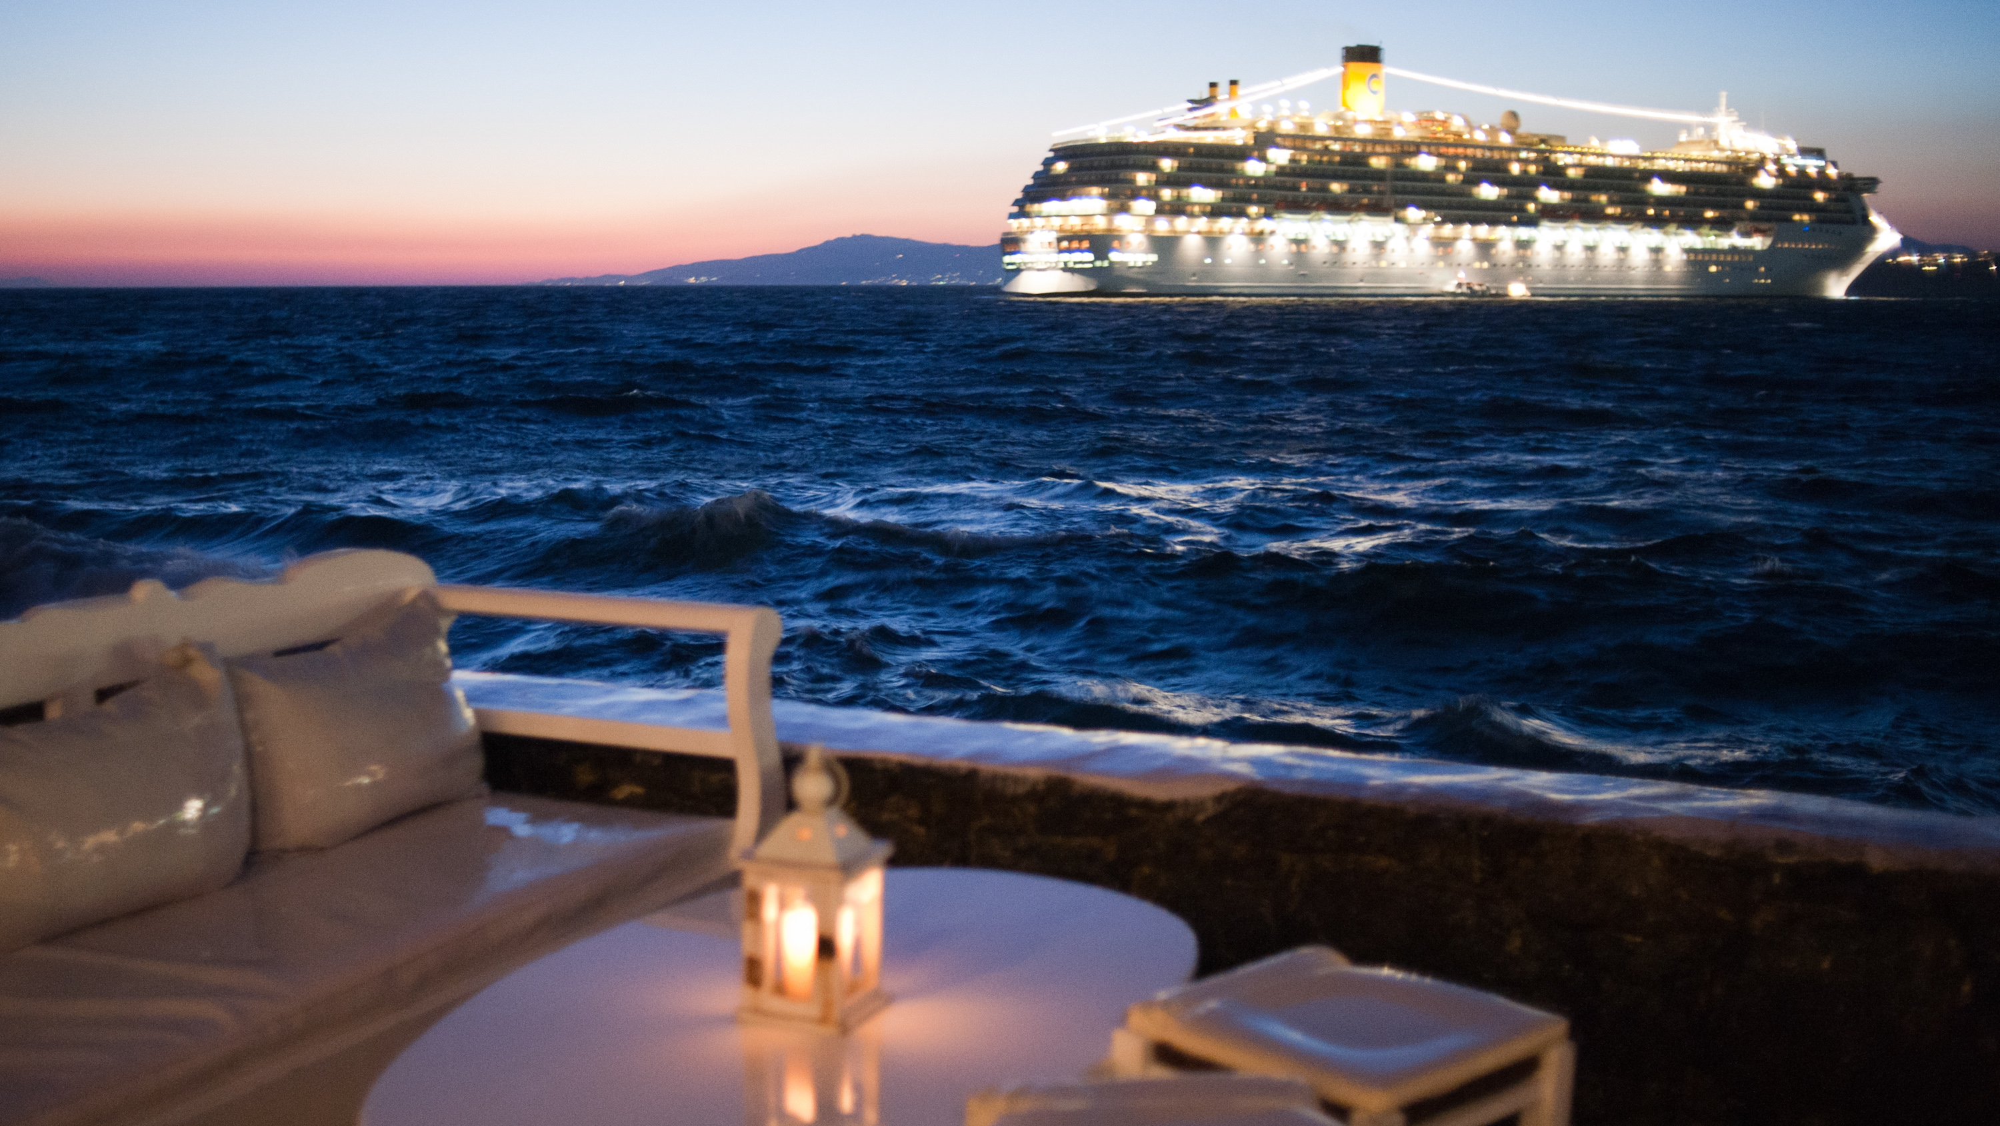
Corfu,the island of relaxation and adventure ,off Greece’s northwest coast in the Ionian sea. Is defined by rugged mountains and a resort-studded shoreline. Its rich multi-culture heritage, its historic monuments, its stunning natural landscape, its crystal clear seas and its excellent weather.
This Photo by Unknown Author is licensed under CC BY-SA

Slide 3
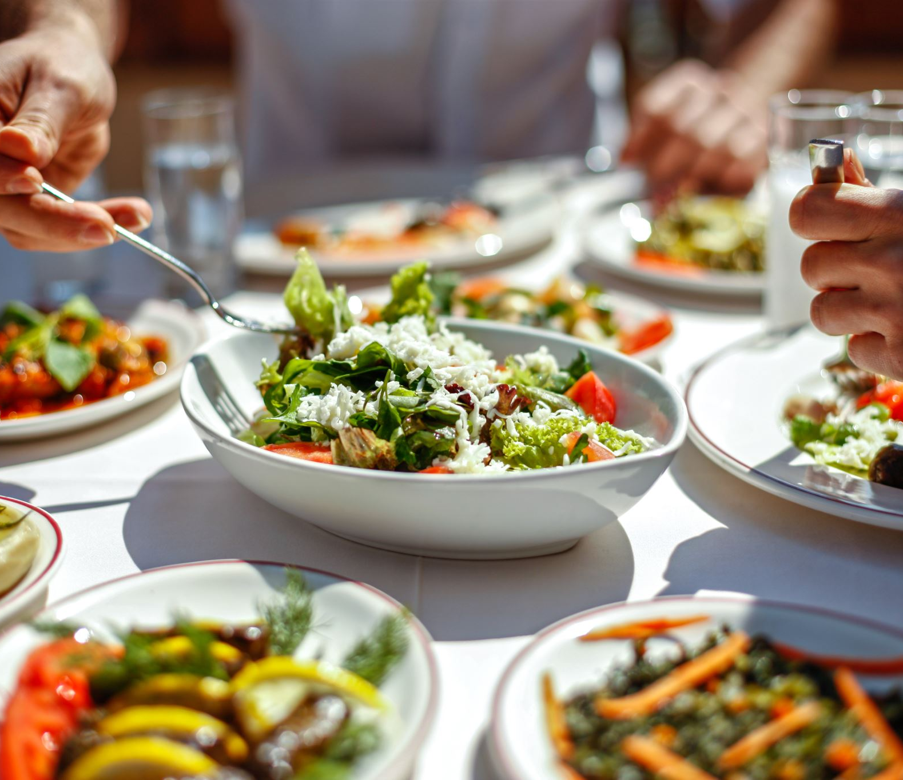
Greek Cuisine
Greek food is everywhere in Greece and the world.

