Slide 1
Fin and angel !
Enjoy your time reading this !!
This Photo by Unknown Author is licensed under CC BY-SA

Slide 2
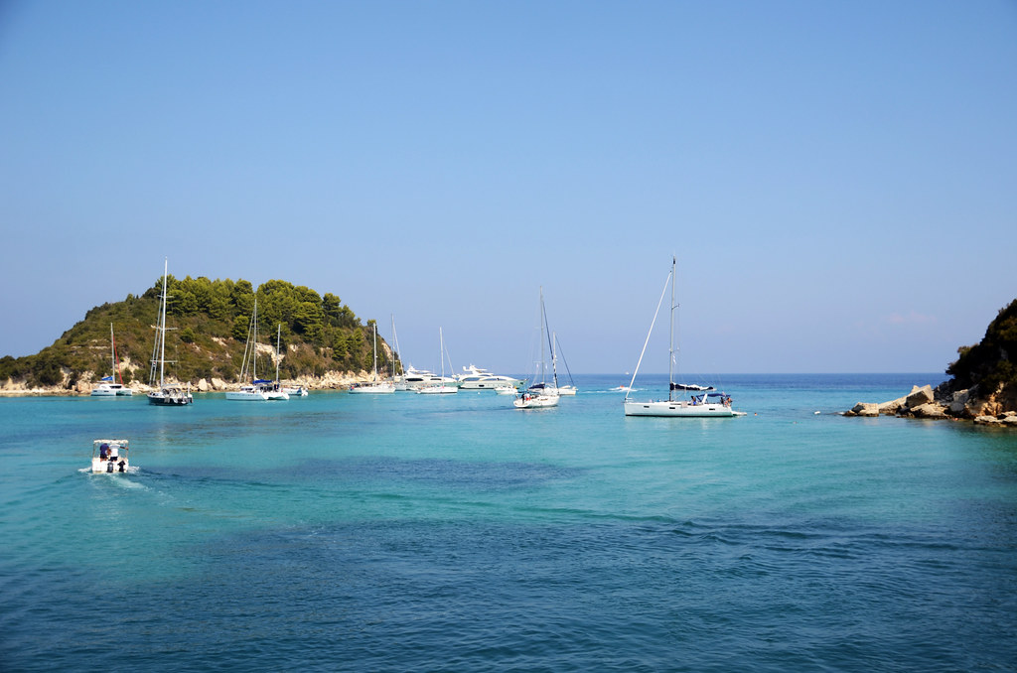
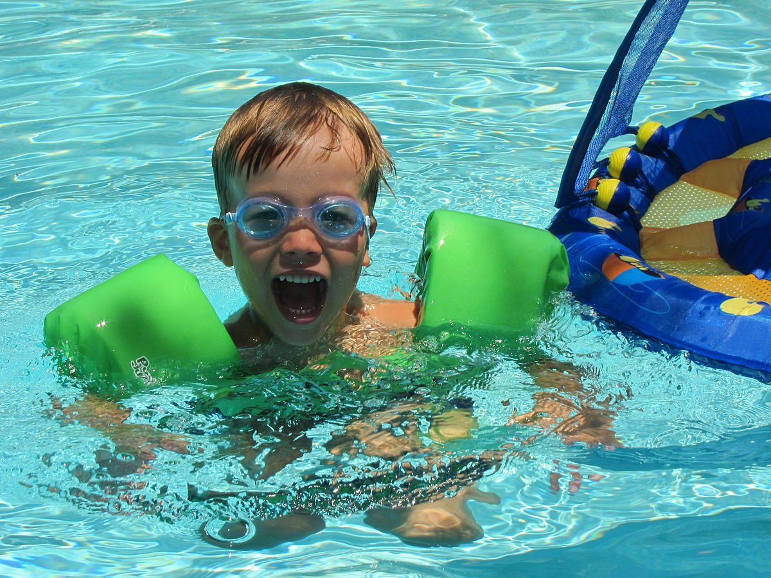
Welcome to Paxos!
The island of dreams !!Paxos is a perfect island where you can relax in peace ,unwind and enjoy the crystal clear waters ! I would suggest you start getting ready!
This Photo by Unknown Author is licensed under CC BY-SA
This Photo by Unknown Author is licensed under CC BY-SA-NC

Slide 3
The beaches!!
Paxos is home to some of the most famous beaches Paxos where you can relax in peace and work on your tan but if your more adventurous get a boat to a nearby island!
This Photo by Unknown Author is licensed under CC BY-SA
This Photo by Unknown Author is licensed under CC BY-SA

Slide 4
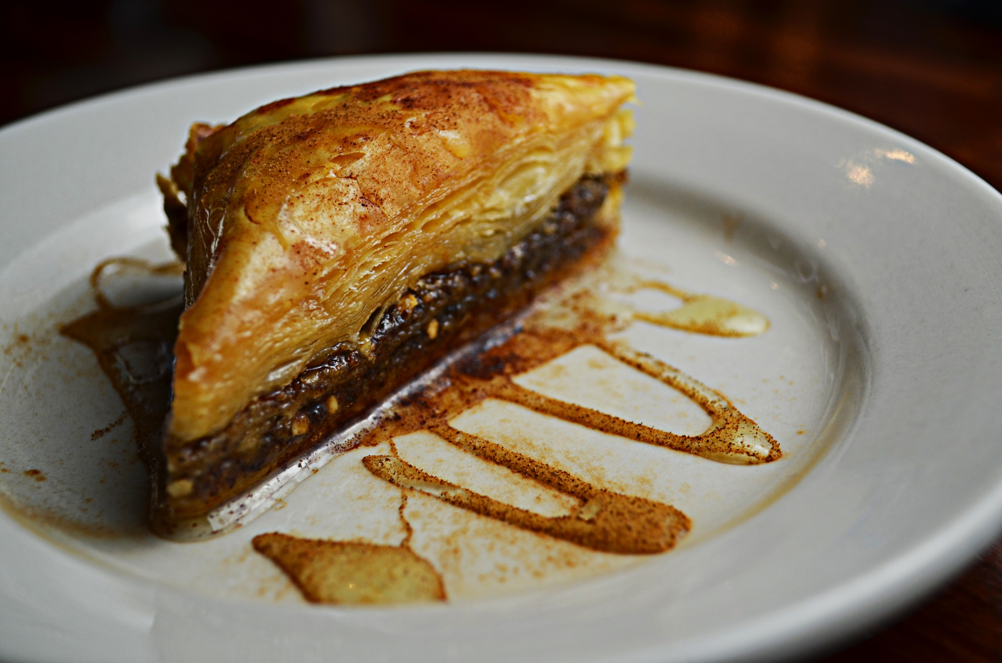
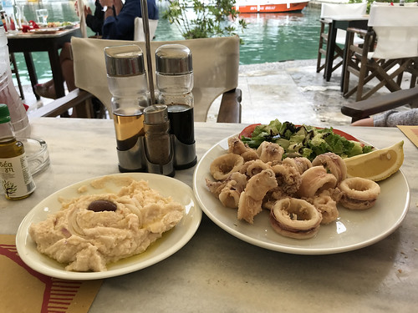
Greek food !!
Greek cuisine is famous around the world and in Paxos ,you could taste it at its famous taste . From mouth-watering fresh Greek salad and yummy baklava the local dishes will confirm any craving !!
This Photo by Unknown Author is licensed under CC BY-NC

Slide 5
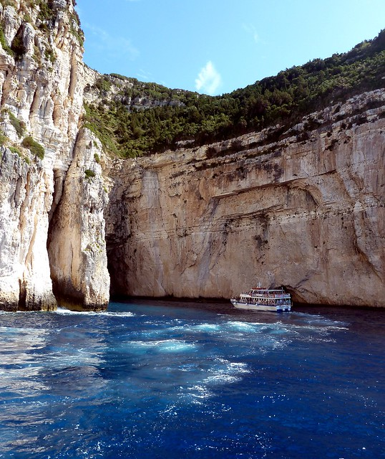
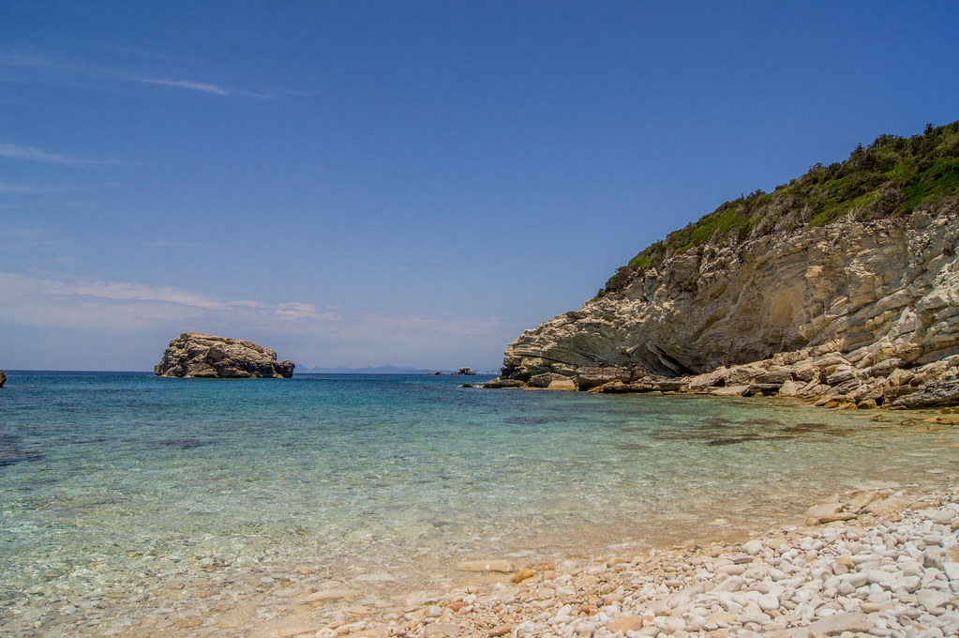
Paxos is amazing !
Its not just a boring old island it’s a peaceful island with its crystal clear waters were you can have a relaxing cold drinks !! Plus it offer like no other and it comes with all year round sunshine !!
This Photo by Unknown Author is licensed under CC BY
This Photo by Unknown Author is licensed under CC BY

Slide 6
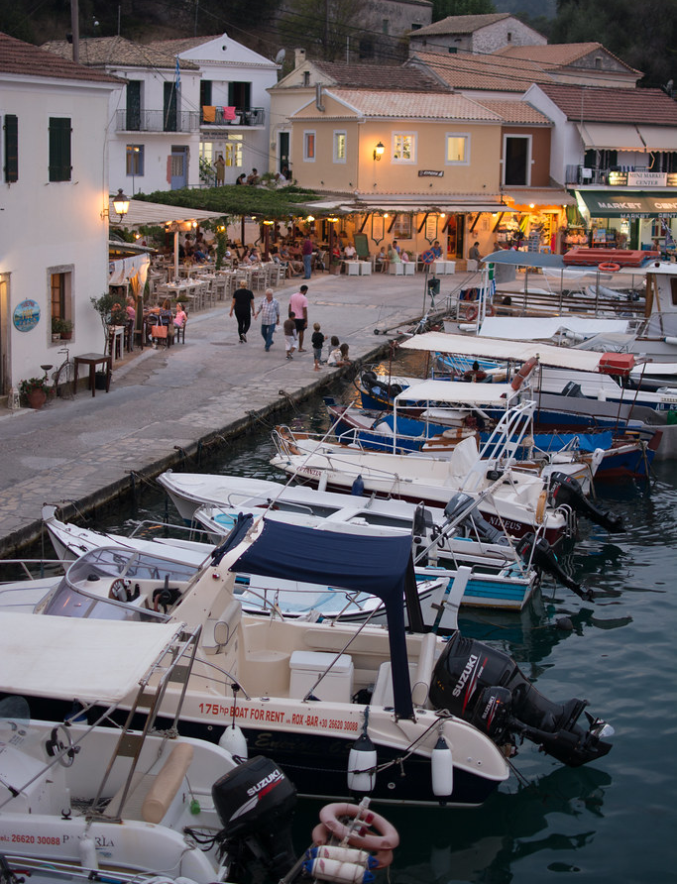
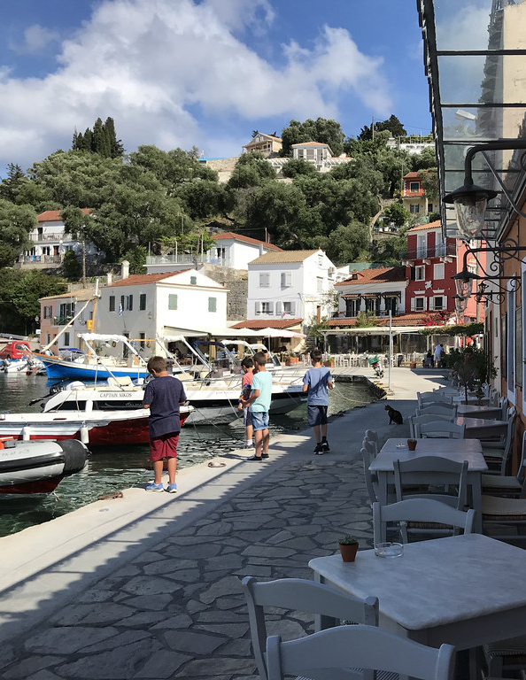
Pictures of Paxos !!
This Photo by Unknown Author is licensed under CC BY-ND
This Photo by Unknown Author is licensed under CC BY-NC
This Photo by Unknown Author is licensed under CC BY-NC-ND

Slide 7
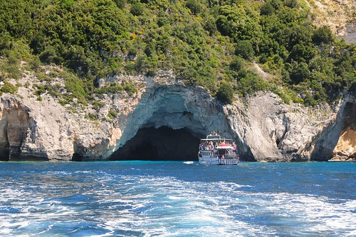
More pictures of Paxos !!
This Photo by Unknown Author is licensed under CC BY
This Photo by Unknown Author is licensed under CC BY

Slide 8
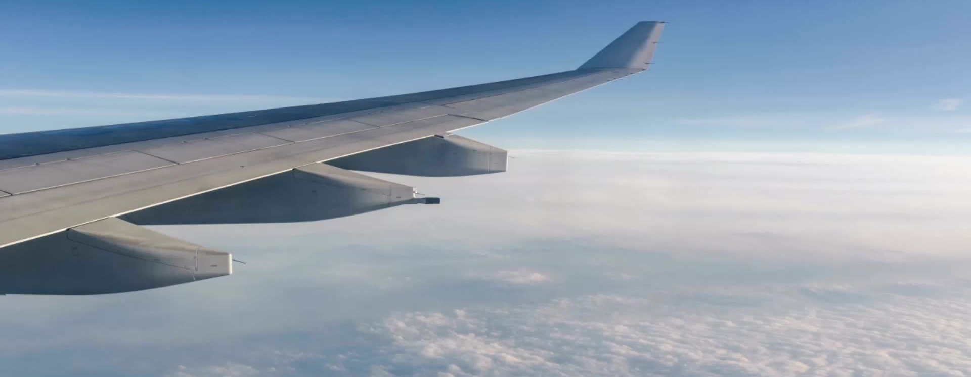
Hurry book a flight NOW !!
So what are you waiting for pack your and go to Paxos NOW before its to late QUICK !!!
This Photo by Unknown Author is licensed under CC BY-SA

Slide 9
Hope you had a good time !!!!
DA END ! TODALOO!☺
This Photo by Unknown Author is licensed under CC BY-NC-ND

