Slide 1
Crete holiday
Prepare yourself to be amazed

Slide 2
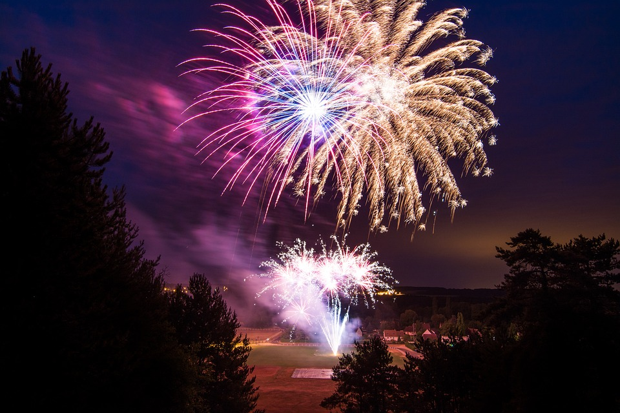
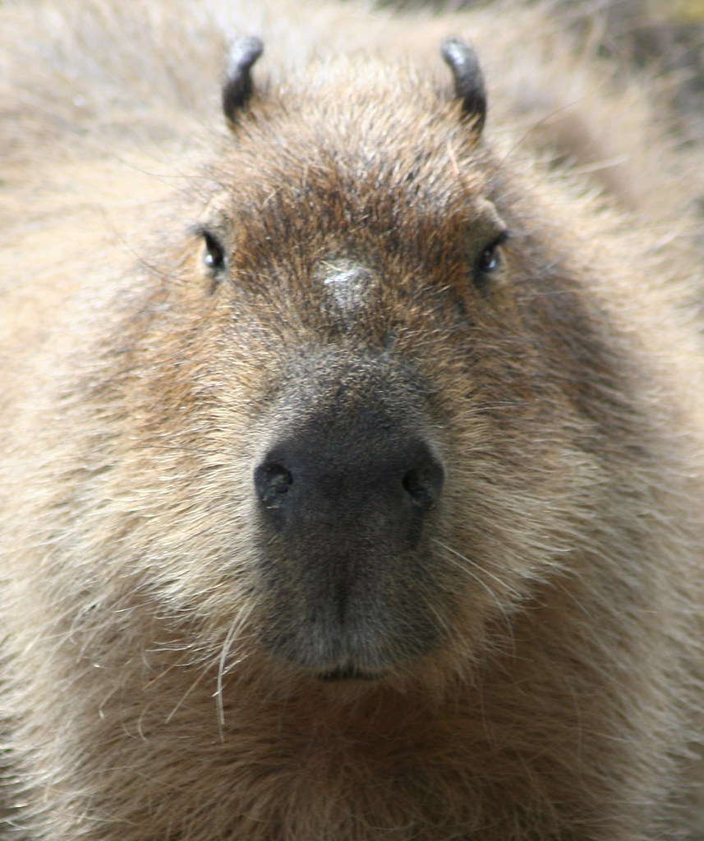
Intro
Hello Greek fans! Welcome to the heven of crete!!!! This is your dream vacation
That will make you fell like your in heven .
This Photo by Unknown Author is licensed under CC BY-SA-NC

Slide 3
1st paragraph
You can relax in a giant soft bed
Wile staring at the crystal clear water.the beaches are amazing! The Greek island perhaps some of the most famous destinations for a lazy beach holiday leaf create right at the top
. From wide expances of golden sand to pebble heven washed with the crysal clear water create beaches ent just a summer vacation it’s a discise as heven

Slide 4
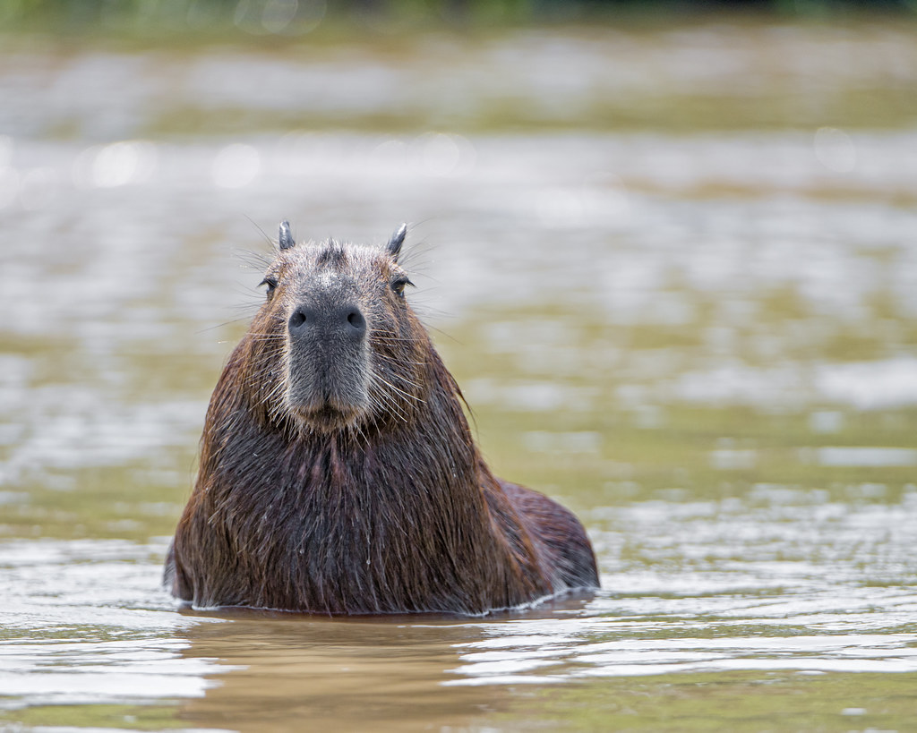
Tap 2 times and wait!!!
Thanks for watching there may be more….
This Photo by Unknown Author is licensed under CC BY-ND

Slide 5
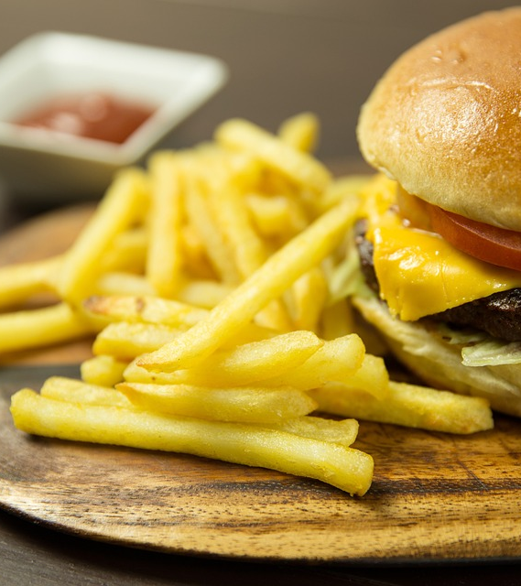
2nd paragraph FOR SCHOOOOL :D
THERES A GREAT RANGE OF FOOD IN CRETE

