Slide 1

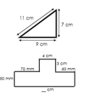
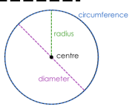
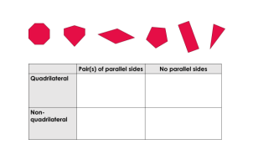
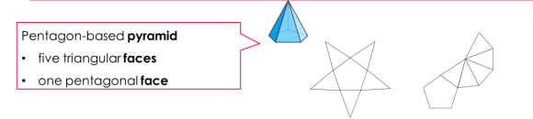
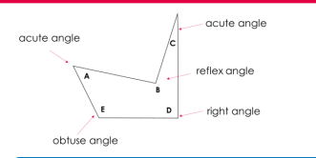
Maths, Year 6 Spring 2
This term I will be learning and practicing
6 Decimals and measures | L1 Linear number sequences with decimals L2 Use, read and write standard units of measure including on scales L3 Interpret mass problems L4 Interpret problems involving mass and Money L5 Reason about the perimeter and area of rectangles L6 Calculate the area of triangles and parallelograms L7 Solve missing side lengths of rectilinear shapes L8 Reason about the area of rectilinear shapes L9 Reason about the perimeter of rectilinear shape L10 Calculate the volume of cubes and cuboids L11 Reason about the volume of cubes and cuboids L12 Convert between miles and kilometres L13 Convert between metric and imperial units of measure
7 Geometry- Angles and properties of shapes (2 weeks) | L1 Categorise, estimate and measure angles L2 Use a protractor to draw angles accurately L4 Calculate unknown angles using known angle facts L5 Solve problems involving angles L6 Compare and classify 2-D shapes L7 Draw 2-D shapes L8 Illustrate and name parts of a circleL9 Compare and classify 3-D shapes L9 Recognise, describe and build 3-D shapes from nets
equivalence

Slide 2

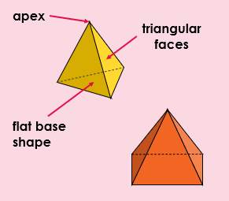
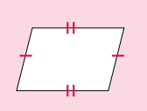
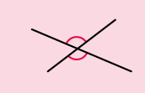
6 | Star Words
Decimals and measures | Base | The bottom side of a shape
 | Imperial Measures | Units of measurement historically used in the UK. These include miles and pints, which are still in use today.
 | height | The vertical distance from the base to the top of the shape
 | triangle | A 2-D shape with three sides and vertices
 | parallelogram | A 2-D shape that is a quadrilateral with two pairs of parallel sides.
 | area | A measurement of the surface of a 2-D shape
 | Volume | Volume is the amount of space that something occupies. It can be measured in cubic units, such as cubic centimetres (cm3) and cubic metres (m3). The volume of a cuboid can be found by multiplying the length by the width by the height
7. Geometry Angles and properties of shapes | Obtuse | Angles between 90 degrees and 180 degrees
 | Apex | The apex is the point at the top of a 3-D shape, like a pyramid or cone, opposite the base, where all the sloping sides meet.
 | apex | The apex is the point at the top of a 3-D shape, like a pyramid or cone, opposite the base, where all the sloping sides meet.
 | reflex | greater than 180 degrees and less than 360 degrees
 | adjacent | Next to
 | prism | A prism is a 3D solid with two identical, parallel bases and otherwise rectangular faces
 | vertically opposite angles

