Slide 1
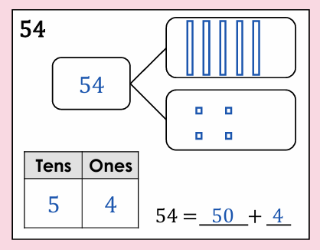
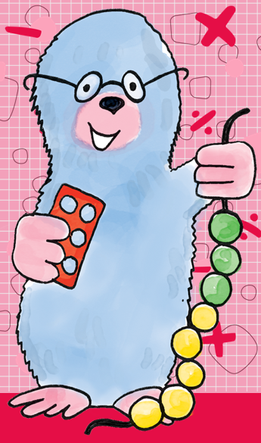
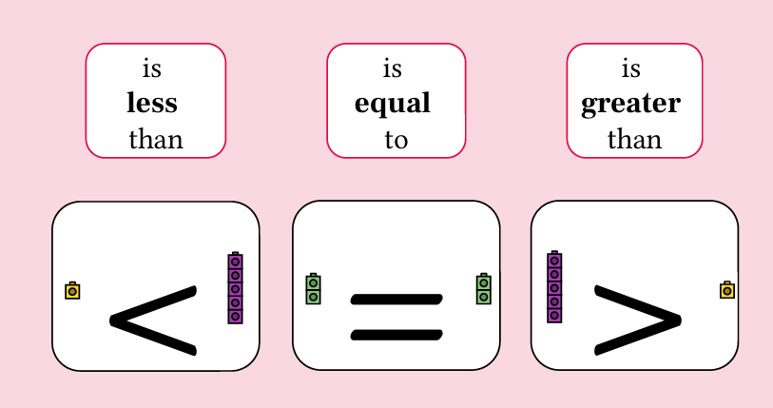
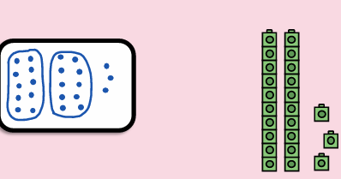
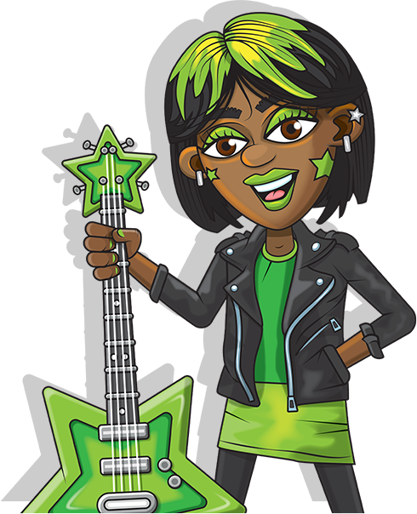

Maths, Year 2, Autumn 1 – Unit 1
Unit 1 Numbers within 100 | I can recognise the place value of each digit in a 2-digit number.
 | I can partition 2-digit numbers.
 | I can read, round and write numbers to 100 in words.
 | I can compare and order numbers to 100.
 | I can explore number patterns.
 | I can compare odd and even numbers.
 | I can count in 2s, 5s, 10s.
 | I can count in 2s, 5s, and 10s
partitioning
Part whole model
Tens and ones
Don’t forget to practice your number skills on Numbots!

Slide 2
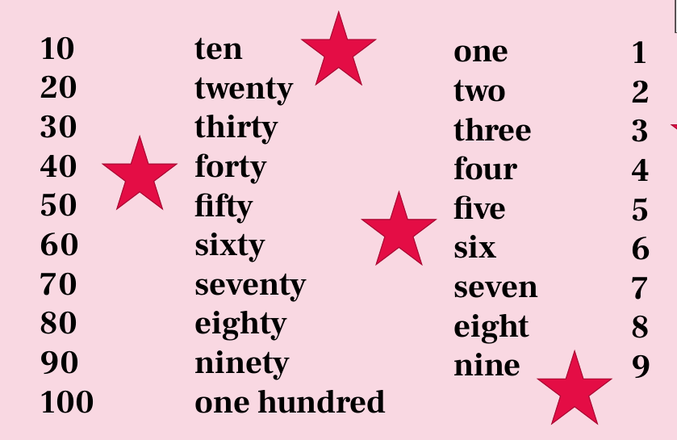
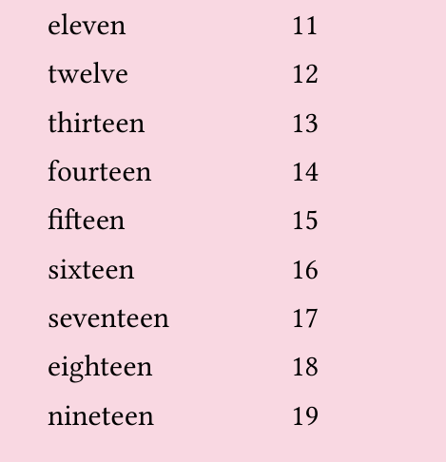
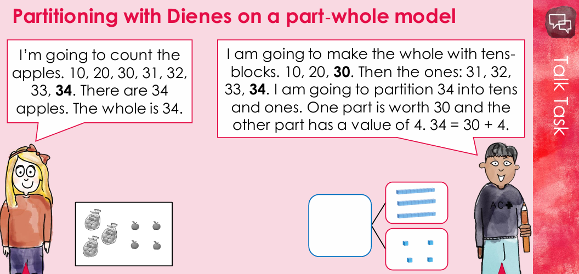
STAR Words
Unit 1 Numbers within 100. | ones | Rightmost digit in a number representing single objects.
 | tens | Second digit from the right showing how many groups of 10..
 | altogether | In total when everything is added together
 | left over | What is left after something is taken away or used.
 | place - value | The position of a digit within a number.
 | digits | A single number used to represent a value (0-9) 1 digit = a single number, 2 digit = a number with more than one digit e.g. 12
 | greater than | One value is larger or has a higher quantity than another.
 | less than | One value is lower or is a fewer quantity than another.
 | equal to | One value is equal to, the same as another.
 | compare | Deciding whether one number or expression is greater, less or equal to another.
 | partition | To split a number into smaller parts.
 | even | A number that can be shared into two equal groups with none left over.
 | odd | A number that cannot be shared into two equal groups because there is one left over
 | greatest | The biggest or largest number or amount.
 | smallest | The smallest or lowest number or amount.
 | more | A greater amount or number of something.
 | fewer | A lesser amount or number of something.
 | increasing | Getting bigger or having more
 | decreasing | Getting smaller or having less
 | forwards | Moving ahead or counting up
 | backwards | Moving behind or counting down

