Slide 1
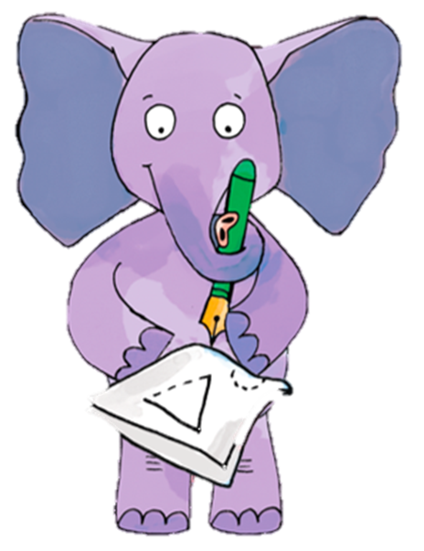
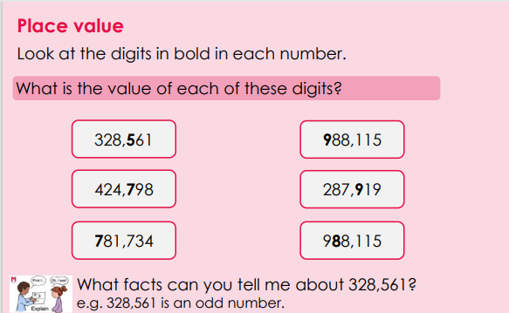
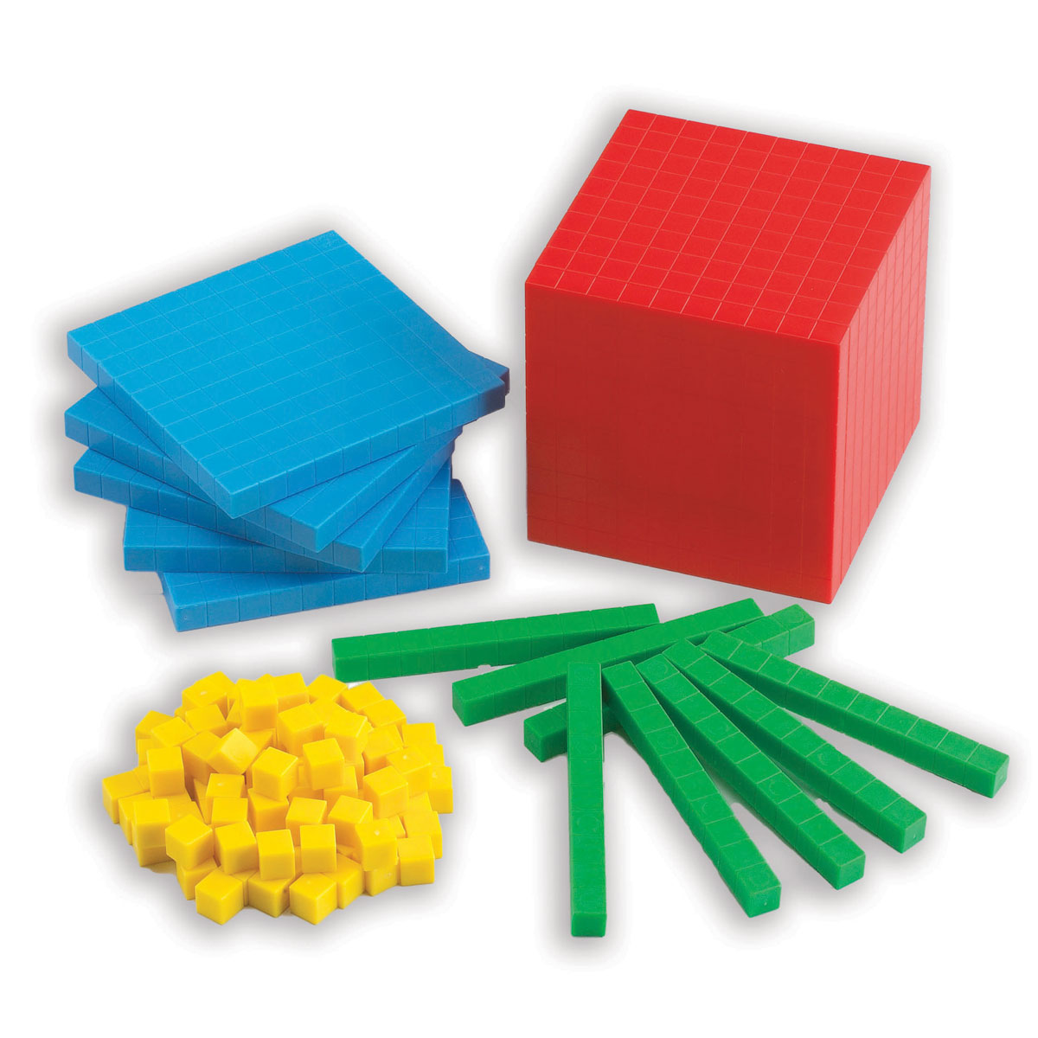
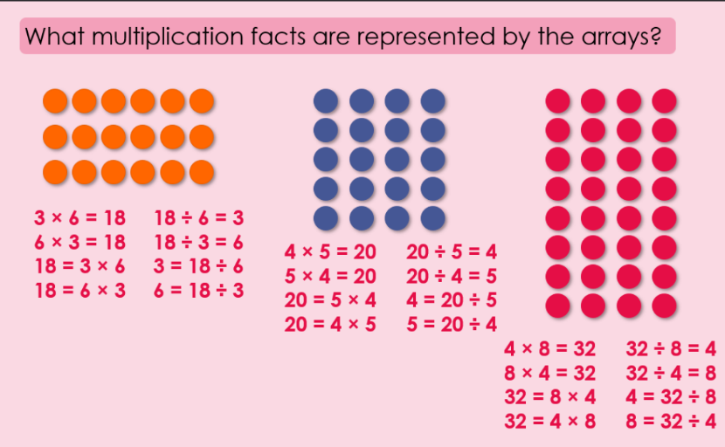
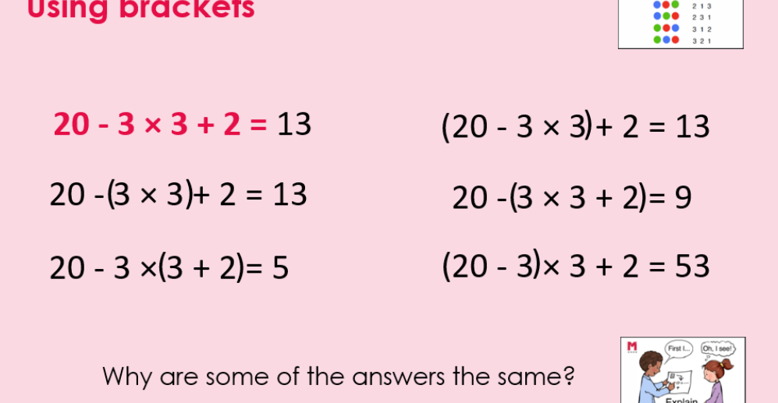
Maths, Year 6, Autumn1
Dienes!
This term I will be learning and practicing
1. Integers & Decimals (2 weeks) | • read, write, order and compare numbers up to 10,000,000 and determine the value of each digit
 | • round any whole number to a required degree of accuracy
 | • solve problems involving addition and subtraction
 | • solve addition and subtraction multi-step problems in contexts, deciding which operations and methods to use and why
2. Multiplication and division (3 weeks) | • identify common factors, common multiples and prime numbers
 | • use estimation to check answers to calculations and determine, in the context of a problem, an appropriate degree of accuracy
 | • multiply multi-digit numbers up to 4 digits by a two-digit whole number using the formal written method of long multiplication
 | • multiply one-digit numbers with up to two decimal places by whole numbers
 | • divide numbers up to 4 digits by a two-digit whole number using the formal written method of long division, and interpret remainders as whole number remainders, fractions, or by rounding, as appropriate for the context
 | • perform mental calculations, including with mixed operations and large numbers
 | • divide numbers up to 4 digits by a two-digit number using the formal written method of short division where appropriate, interpreting remainders according to the context
3. Calculation problems (2 weeks) | find pairs of numbers that satisfy an equation with two unknowns
 | • use knowledge of the order of operations to carry out calculations involving the four operations
 | • generate and describe linear number sequences • express missing number problems algebraically
 | • solve problems involving addition, subtraction, multiplication and division
 | enumerate possibilities of combinations of two variables
Prime numbers

Slide 2
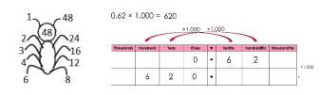
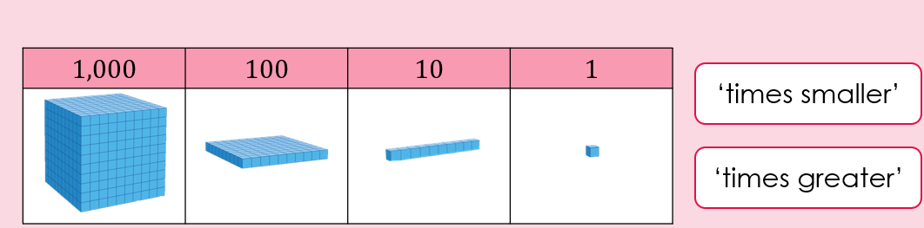
STAR Words
1. Integers & Decimals (2 weeks) | ones | Rightmost digit in a number representing single objects.
 | tens | Second digit from the right showing how many groups of 10..
 | hundreds | Third digit from the right showing how many groups of 100.
 | whole | A whole number with no decimal or fraction.
 | part -whole | How a whole number divided into smaller parts.
 | place value | The position of a digit within a number.
 | Digit | A digit is a single number from 0 to 9.
 | Value | This refers to how much something is worth. In math, the value of a digit depends on its place in a number.
 | Place holder | A place holder keeps the position of digits in a number, especially when a digit is zero.
 | Greater Than ( > ) | Shows that one number is bigger than another.
 | Less than | Shows that one number is smaller than another
 | interval | A range of numbers between two given numbers e.g. between 5 and 10.
2. Multiplication and division (3 weeks) | Common factor | A number that is a factor of two or more numbers.
 | Common multiple | A number that is a multiple of two or more numbers.
 | Composite numbers | A composite number can be divided evenly by 1, itself, and at least one other number.
 | factor | A number that divides exactly into another number
 | product | The answer you get when you multiply numbers
 | equivalent | Means equal in value, even if they look different.
 | simplify | To make something easier or shorter, usually by reducing to the smallest form
 | Prime number | A number greater than 1 that has only two factors: 1 and itself.
3. Calculation problems | operation | An operation is a math action you do to numbers.
 | priority | Priority in maths means the order in which operations are done, especially when there is more than one operation.
 | order | Order is the sequence in which math steps are carried out. The rules for this are called Order of Operations (often remembered by BODMAS or PEMDAS):
Inverse
Forward: 4 + 5 = 9
Inverse: 9 − 5 = 4
Forward: 6 × 2 = 12
Inverse: 12 ÷ 2 = 6

