Slide 1
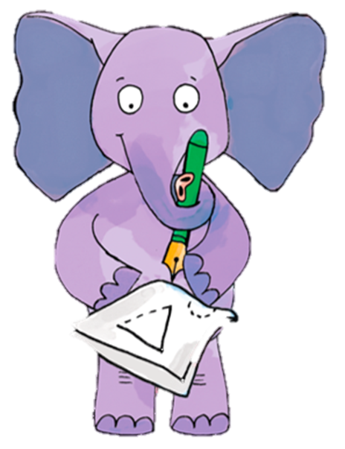


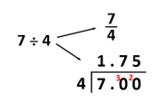
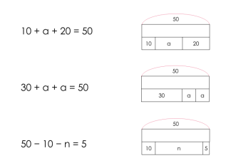
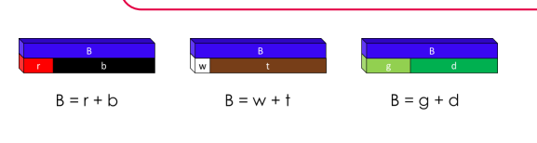
Maths, Year 6, Autumn 2
This term I will be learning and practicing
3. Calculation problems (2 weeks) | Understanding the agreed order of operations L1 Understand which operations have equal priority . L2 Understand the order of operations L3 Understand the order of operations, including indices L4 Understand the order of operations, including brackets L5 Solve problems involving the order of operations L6 Solve algebraic equations with one unknown value L7 Solve algebraic equations with two unknown values L8 Use a letter to represent a number in contextual problems L9 Generate and describe linear number sequence
4. Decimals | L1 Identify, describe and represent fractions L2 Understand and describe fraction equivalence L3 Find equivalent fractions in their simplest form Comparing and ordering fractions L4 Compare and order fractions L5 Compare and convert mixed number and improper fractions L6 Order fractions greater than one L7&8 Add and subtract fractions with different denominators L9 Multiply an integer by a fraction L10 Multiply two fractions L11 Divide a fraction by an integer L12 Solve problems involving fractions L13 Recall and use fraction and decimal equivalence L14 Calculate decimal equivalence using short division
5. Percentages (with fraction and decimal equivalence) | L1 convert percentages into decimals and fractions L2 convert fractions into percentages and decimals L3/4 solve fraction-decimal-percentage problems L5 find percentages of quantities (1) L6 find percentages of quantities (2) L8 choose an efficient strategy to find percentages of quantities L9 interpret and solve problems involving percentages
equivalence

Slide 2
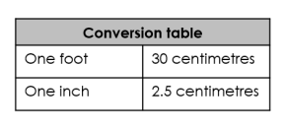
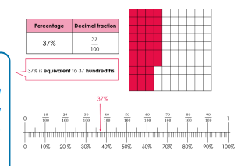
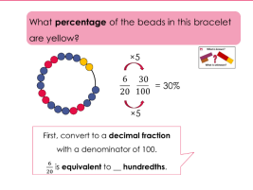
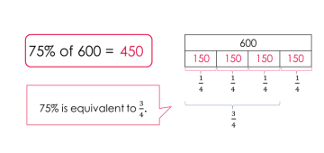
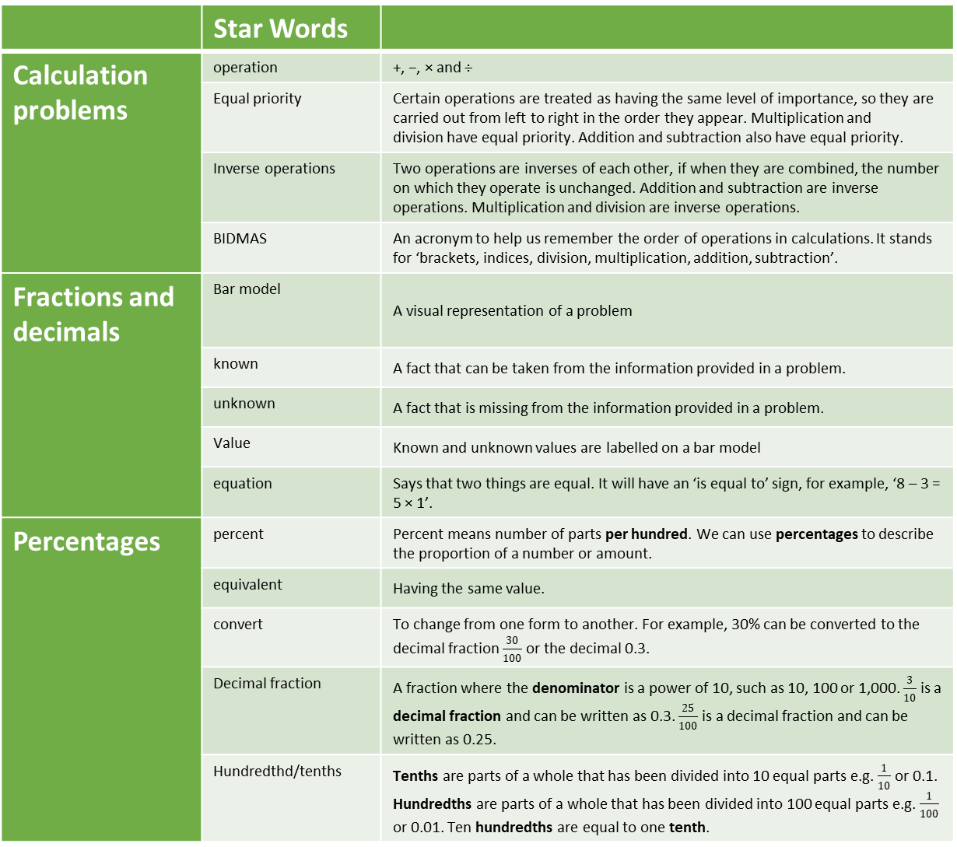
 | Star Words
Calculation problems | operation | +, −, × and ÷
 | Equal priority | Certain operations are treated as having the same level of importance, so they are carried out from left to right in the order they appear. Multiplication and division have equal priority. Addition and subtraction also have equal priority.
 | Inverse operations | Two operations are inverses of each other, if when they are combined, the number on which they operate is unchanged. Addition and subtraction are inverse operations. Multiplication and division are inverse operations.
 | BIDMAS | An acronym to help us remember the order of operations in calculations. It stands for ‘brackets, indices, division, multiplication, addition, subtraction’.
Fractions and decimals | Bar model | A visual representation of a problem
 | known | A fact that can be taken from the information provided in a problem.
 | unknown | A fact that is missing from the information provided in a problem.
 | Value | Known and unknown values are labelled on a bar model
 | equation | Says that two things are equal. It will have an ‘is equal to’ sign, for example, ‘8 – 3 = 5 × 1’.
Percentages | percent | Percent means number of parts per hundred. We can use percentages to describe the proportion of a number or amount.
 | equivalent | Having the same value.
 | convert | To change from one form to another. For example, 30% can be converted to the decimal fraction $\frac{30}{100}$ or the decimal 0.3.
 | Decimal fraction | A fraction where the denominator is a power of 10, such as 10, 100 or 1,000. $\frac{3}{10}$ is a decimal fraction and can be written as 0.3. $\frac{25}{100}$ is a decimal fraction and can be written as 0.25.
 | Hundredthd/tenths | Tenths are parts of a whole that has been divided into 10 equal parts e.g. $\frac{1}{10}$ or 0.1. Hundredths are parts of a whole that has been divided into 100 equal parts e.g. $\frac{1}{100}$ or 0.01. Ten hundredths are equal to one tenth.
Inverse

