Slide 2


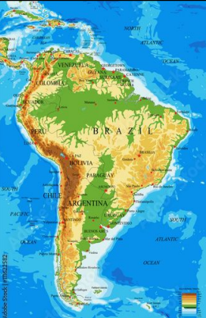
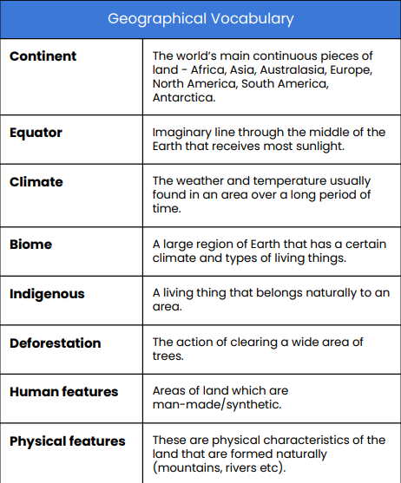
Year 6 Spring 1 Knowledge Organiser
Key Questions
What is the significance of Brazil’s location? ,
What are Brazil’s biomes?
Can you describe Brazil’s physical geography?
How important is the Amazon rainforest , ?
How has Brazil been urbanised?,
Can you describe the culture of Brazil ,
Why is Rio de Janeiro a tourist destination?
In this topic, year 6 will explore the geographical significance of Brazil, including its diverse biomes and physical geography. They will learn about the importance of the Amazon rainforest, the impacts of urbanisation, and the rich cultural heritage of Brazil. Additionally, they will examine the reasons behind Rio de Janeiro's popularity as a tourist destination and the challenges Brazil faces in terms of environmental sustainability. Through this comprehensive study, students will gain a deeper understanding of Brazil's role in the world and the interconnectedness of its natural and cultural landscapes.

Slide 3
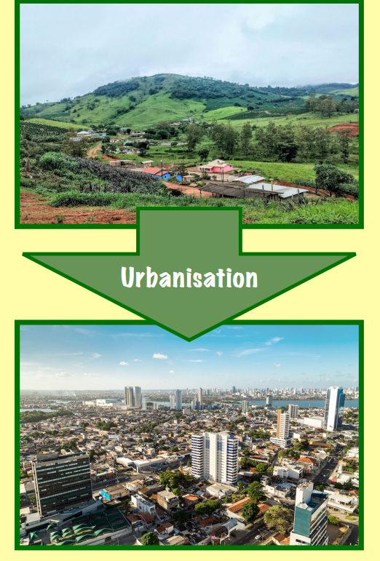
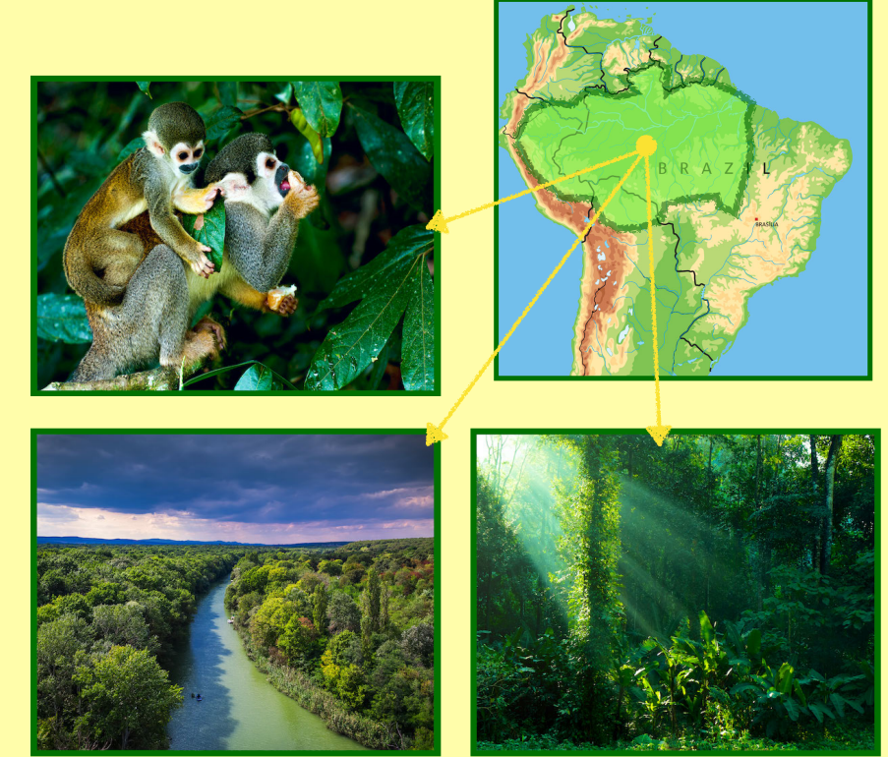

Useful websites
BBC Bitesize - Brazil
National Geographic - Brazil
Kids World Travel Guide - Brazil Facts
Ducksters - Brazil
Official Brazilian Government Website

